Slide 1
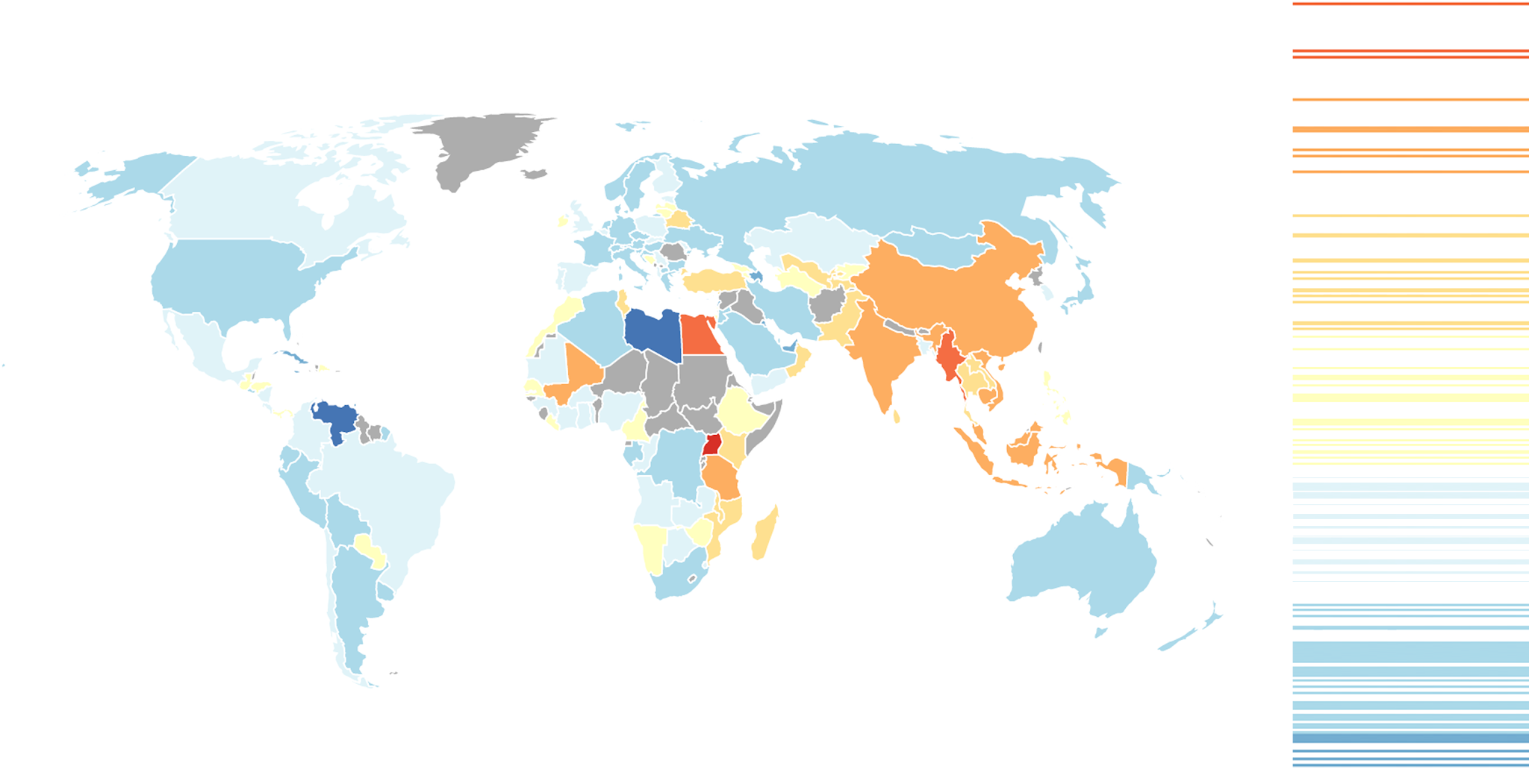
The Economic Complexity Index
Dave Gunaratnam, Haoxian Chen, Rohan Macherla, Ajit Akole, Shomik Ghose 2021
Notes:
As all of humanity continues to amass terabytes of data we often find ourselves in predicament of finding innovative ways to utilize the data to improve the way we make decisions. The creation and utilization of the Economic Complexity Index does not deviate from this common goal and in fact is an approach to use data to answer an incredibly important question: What is the optimal development strategy for a country that leads to stable growth with minimal risk to its citizens?
Hidalgo & Hussman created the quantitative foundation to begin to answer this question by creating the Economic Complexity Index. Using this metric in unison with other macroeconomic indicators we can begin to understand not only the output a country can produce but rather the capacity a country’s economy possesses. We can develop optimal paths of development for countries and suggest contingency strategies if tail events affect a particular country’s economy. The ECI captures information about an economy that traditional macroeconomic indicators do not and thus it and its derivatives serve as a useful tool in analyzing economic systems.

Slide 2
Economic Complexity - Intuition
Two Different Economic Lenses
Traditional View:
Economies are a combination of raw materials, labor, and capital that colaese to create products and services
Economic Complexity:
Products and services are actually an aggregation of knowledge that actors within an economy possess.
A breadth of knowledge allows for more interplay between knowledge sources and hence leads to more complex products
Notes:
The traditional economic view is something we are all familiar with. There are basic components that in aggregate create an economic system, namely raw material, labor, and capital. These three components are naturally measurable quantities which leads to many macroeconomic indicators to rely directly or indirectly on these particular components.
The Economic Complexity framework fundamentally changes the base unit. Within the ECI framework we view the basic unit in any economic system as knowledge. We do not mean this in a esoteric manner, rather we mean that the capacity for an economy to create output actors within the economic system must have pieces of knowledge that allow them to create value. The aggregation of pieces of knowledge that are spread across the people coalesces such that economic systems are able to create product and services. In essence we completely transform how we view a economic system. The claim of the ECI framework is that it may be more reasonable to think of a economy as a complex system where pieces of knowledge are interwoven and interconnected in a massive web. The potential of an economy is stored within this web of knowledge.

Slide 3

Consider for just a moment the knowledge needed to create toothpaste…
You probably have very little knowledge of chemical components or the properties of the substance itself.
Slowly we begin to realize that most of the products around us are created using sources of knowledge that are far beyond our own individual knowledge
The key is that each person has specialized knowledge making us in aggregate very knowledgeable
This is the defining aspect of modern society
Notes:
We realize the conception of an economic system that we’ve introduced in the previous slide seems a bit abstract so we’ll pose an example that may help concretize the ECI framework. Consider for a moment the toothpaste that you use on a daily basis. Do you know what particular chemicals are used to create it? Do you understand the properties of the components inside the toothpaste and why they are useful in context of personal hygiene? Do you understand how the manufacturing process is done or how to setup a large plant to mass produce toothpaste bottles? We could continue with this type of questioning and most of us would admit that we answered no to most of these questions. If we think a bit more we begin to realize that this type of reasoning can be applied to most of things we interact on a daily basis. Imagine the long list of questions one could ask about how our phones work!
While a quick assessment of this phenomenon may lead to believe that this is a weakness, in actuality this is one of the greatest strengths modernity. We are able to specialize and by putting together our small subsets of knowledge we are able to create very complex products and systems. Thus economies in aggregate are incredibly knowledgeable and that in essence is what ECI is attempting to measure.

Slide 4

Intuition
We are not as concerned about how much knowledge a country has but the diversity of knowledge it has and how its different types of knowledge interact
Economic Complexity then has its foundations in Adam Smith’s idea of division of labor.
Modern societies have succeeded because individuals have small but specialized amounts of knowledge, which we refer to as a personbytes.
Can we use these ideas to build an economic indicator that reflects this particular economic perspective...
Notes:
We see that there is a very stark similarity between the ECI conception and Adam Smith’s idea of the division of labor. The small pieces of knowledge that each individual has is defined as a personbyte. The aggregation of personbytes is the total knowledge of an economy. Importantly, the power of the system comes from the fact that there is a wide diversity of personbytes. Having a wide range of personbytes allows more complex interconnections between the knowledge bases and allow for the development of more complex products.
The remaining question is: how can we design an economic indicator that encompasses this economic view of knowledge-bases and personbytes?

Slide 5

Building the Economic Complexity Index
We want some type of quantitative metric that measures the amount of knowledge embedded in a country’s economy.
It should account for the different types of knowledge that people have within the economy and how those types of knowledge interact
It should reflect the actual/potential capabilities an economy possesses rather than measuring raw output
Let’s now dig deeper into categorizing different types of knowledge...
Notes:
The economic indicator that we would like to create needs to have a few key properties as we have listed above. It needs to capture how much knowledge an economy has. It must account for a vast variety of knowledge within an economy since those economies with a variety of personbytes are more capable of combining different skill sets to create a more complex products. Finally, as we have said before, we are interested in the potential of an economic system rather than the raw output. Understanding potential of an economy gives us a better idea of the types of knowledge that an economy possesses.
Before we are able to actually construct the metric we need to define a few extra terms that will assist us in the process of creating the Economic Complexity Index.

Slide 6
Tacit vs Explicit Knowledge
Explicit Knowledge: Forms of knowledge that can easily be transferred upon communication
  Ex. Today’s weather, Population of the United States, Number of planets in solar system
Tacit Knowledge: Forms of knowledge which are more difficult to pick up upon immediate communication
  Ex. How to manufacture a car, Programming an app, Learning a new language
If all forms of knowledge were Explicit, countries would be able to pick up on new skills and technologies almost immediately, thus reducing the gap in economic development
However, picking up on Tacit Knowledge is costly and time consuming
  The solution: Specialization!
Notes:
What is knowledge? Knowledge can range from anything including the results of last night’s game, to yesterday’s closing price of the S&P. It can also range to skills that we gain, whether that be how to change a light bulb, program an app, or knit a sweater! Formally, we can split the space of knowledge into two different categories: Tacit, and Explicit. Explicit knowledge consists of the pieces of information that can easily be transferred and communicated, not requiring significant effort to retain. This consists of simple facts, pieces of news, or statistics. On the other hand, tacit knowledge consists of the forms of skills and information that cannot be immediately picked up, and require some amount of time to actually pick up and retain.
This is relevant to our discussion, as for countries’ production, not all forms of knowledge are explicit. If that were the case, any country would be able to develop advanced technology, and just as easily pivot into drilling for oil, or manufacturing chemicals. In reality, the majority of industry development lies in tacit knowledge, that is costly and time consuming to pick up. As a result, most countries focus on a few industries that they already have a strong base of knowledge to implement at an efficient level. Formally, this is known as specialization!

Slide 7
Scrabble Tile Analogy
C
A
R
The more letters, the more words one can form with them -- in other words, the more capabilities, the more products a country can develop → Diversity
Longer, more complex words, are likely to be formed by less people due to the costs required to build the word -- in other words, more complex products that require a greater combination of capabilities can only be created by a smaller group of countries → Ubiquity
Individual letters represent specific capabilities, which can come together to form multiple different words, or products
Notes:
Imagine pieces of knowledge being represented as scrabble tiles, where each tile represents a specific capability of a country’s workforce. These tiles can come together to form words, which represent the actual products/industries. If a country has more pieces it can put together more words, or types of products. In other words, the country’s economy would have a higher level of diversity if it’s able to generate more products with more capabilities.
Similarly, complicated words generally require more pieces, and can only be formed by a smaller group of people (think about the tiles that would go into forming the word “Pochemuchka”, versus a word such as “run.” A Country’s ability to form more complex products that require a wider range of capabilities can be defined as Ubiquity.

Slide 8

ECI Calculation
The calculation of ECI is primarily based on comparative advantages in production.
Revealed Comparative Advantages (RCA): It measures the relative advantage of a country producing a product than other countries.
Mathematical expression:
where Xcp means the export value of a country c in product p
Intuition: A country possesses a product advantage if it produces more than a product’s “fair” share.
Notes:
The calculation of ECI is mainly based on comparative advantages of countries in producing certain products. In order to define comparative advantage, we bring up a concept called revealed comparative advantage, also called RCA. When considering the advantage of a country in producing certain product, we cannot just measure it by how much a country produces. For example, it is not fair to compare the volume of exports of a product in China with the one in Uruguay. Similarly, we also want the products taking up a large part of the world trade to represent a larger share than those with small part. Therefore, RCA measures in the following way. It measures the ratio between the share of a country in producing certain product and the share of a product in total world trade volume, which is also called a “fair” share of a product in the world.

Slide 9
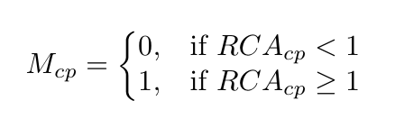
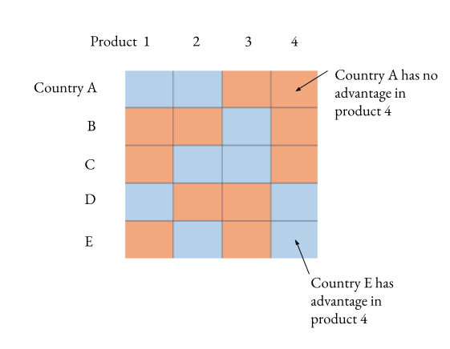
ECI Calculation
Matrix of comparative advantage: A matrix to show a holistic overview in the comparative advantage among all the countries in all the products.
Binary definition: The entries in matrix of comparative advantage are 0’s or 1’s. 0 denotes that a country does not have comparative advantage in producing a product and vice versa.
Mathematical Expression:
Notes:
Since there is a value for each country and each product, we can use a matrix to represent all the values, and the shape of the matrix is number of countries by number of products. However, a question is that even with these values, how can people measure whether a country has comparative advantage in producing a certain product. According to Hausmann and Hidalgo, who is the inventor of ECI, when the RCA value is greater than or equal to 1, we regard this country has a comparative advantage in producing this product. Similar for the other case. Therefore, eventually the matrix of RCA becomes a matrix of comparative advantage, where all the entries are either 0 or 1, representing the comparative advantage of production.

Slide 10


ECI Calculation
The calculation of ECI is based on the iterative correction between the diversity of a country product space and the ubiquity of the products that a country produces.
Diversity
A term defined for country
It measures how many products that a country is “dominantly” producing
Drawback: it cannot tell whether the products being produced are high-end or low-end
Ubiquity
A term defined for product
It measures how many countries are “dominantly” producing a product
Drawback: it cannot tell whether those countries are more or less developed
Notes:
After having a metric to measure comparative advantage in production, there are the other two essential tools in calculating the ECI of a country, which are diversity and ubiquity. Diversity is a term defined for country. It can tell how diverse it is for the product space of a country. In other words, a country with advantages in producing more products tend to have a higher diversity. Similarly, ubiquity is a term defined for products. It can tell how many countries are having advantages in producing a product. However, unlike diversity, a lower ubiquity value means better, since there are less countries with producing advantages.
However, there are drawbacks with these two metrics, even though a country has a very high diversity, it does not mean this country is so developed that it can produce many products. Similar to ubiquity. Even though a product has a very low ubiquity value, it is not necessary that this product is hard to be produced so that there are not so many countries having advantages in production. It can be a product that is been outdated. Therefore, it is not enough to just use these two metrics to tell whether a country is developed or a product is high-end or not.

Slide 11
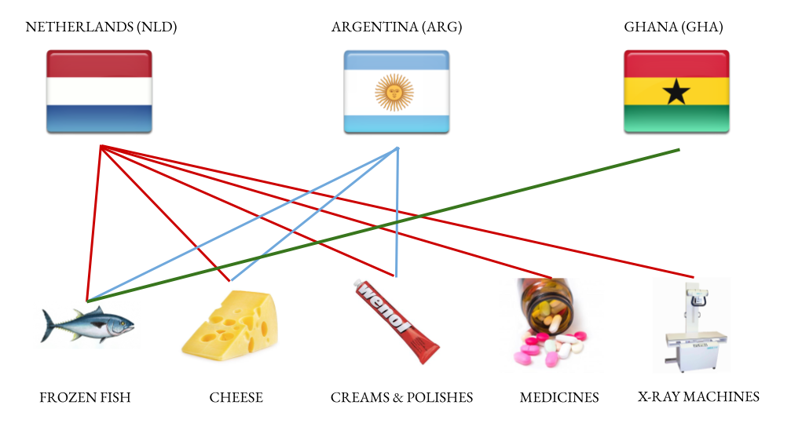
Diversity & Ubiquity Visualization
Notes:
The picture here gives an example of diversity and ubiquity. For diversity, from the picture, we can see that Netherlands is able to produce all of the products, Argentina is able to produce the first three products, and Ghana is only able to produce the first one. Therefore, from the angle of diversity, Netherlands has higher diversity than Argentina, and Argentina is higher than Ghana as well. That means countries with more complex product space tend to have higher diversity.
On the contrary, products produced by less countries tend to have higher ubiquity. As an example, the X-ray machines mentioned in the picture has a higher ubiquity than frozen fish because there are three countries producing frozen fish but only one country producing x-ray machines.

Slide 12


ECI Calculation
Since diversity and ubiquity can speak for each other, we can create a connection between these two quantities.
Modified diversity:
Modified ubiquity:
ECI can be calculated by the standardization of solution of the equation:
Notes:
As we mentioned before, only diversity and ubiquity is not enough for telling whether a country is developed or a product is highly complex. Therefore, we also put forward the recursive versions of diversity or ubiquity. In addition to diversity itself, the recursive diversity also incorporates the information of ubiquity. So it is defined as the summation of all the products that the country has advantage in producing weighted by the products ubiquity, and then normalized by the original diversity so that the value will not be too large after many iterations. Similar to ubiquity, it is defined as the summation of all the countries that have advantage in producing a product weighted by the countries’ diversities, and then normalized by the original ubiquity. As you can see, if we plug in recursive ubiquity into recursive diversity, we can obtain an equation only related to diversity, and as N goes large enough, it becomes an implicit formula about the diversity itself. Then we can solve this equation to obtain the diversity, also the economic complexity, of a country. Mathematically, it is about solving for an eigenvector.

Slide 13
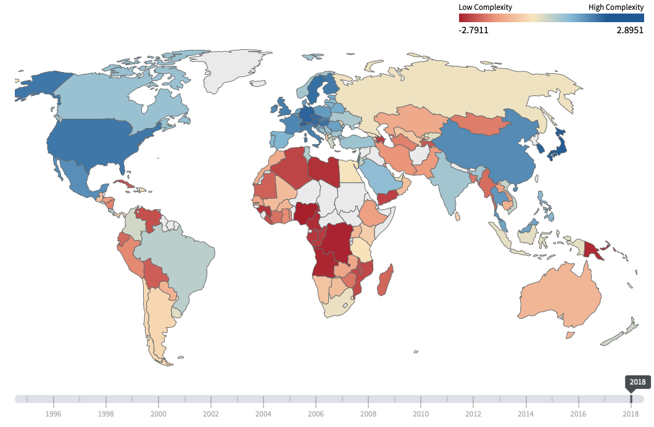
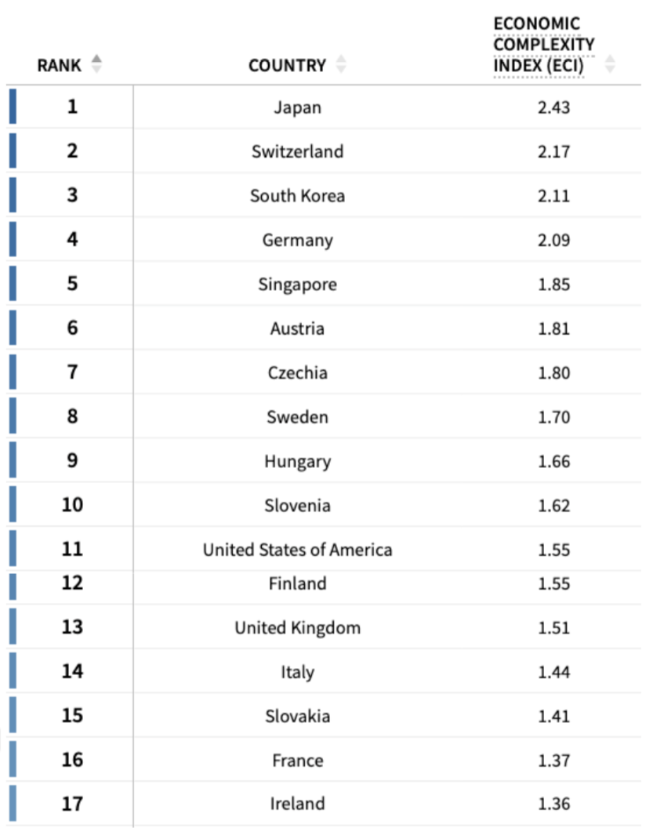
ECI World Map - Visualization
Notes:
This is a worldwide view of all the countries in terms of economic complexity. This result refers to the one in Harvard Altas Lab. As you can see, the result of ECI is still in accordance with other economic metrics, like GDP. Many countries regarded as economic entity with strong productivity have high economic complexity. Additionally, some countries with high ECI values are listed out here. Recently, Japan remains to be the top in terms of ECI. Other countries with high ECI values are like Switzerland, South Korea, Germany etc.

Slide 14
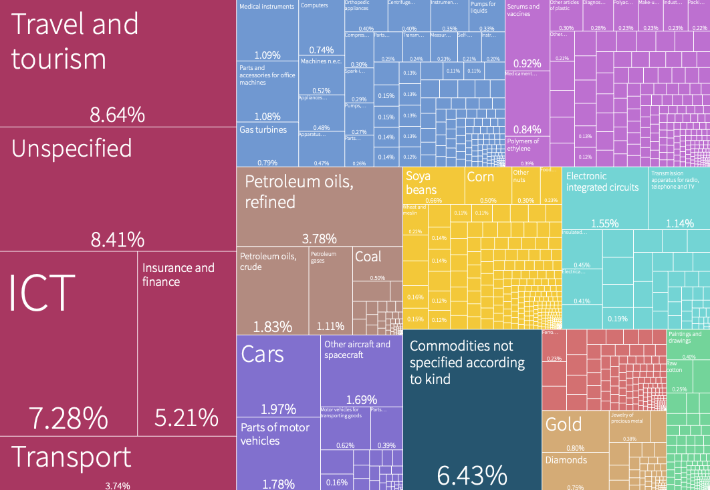
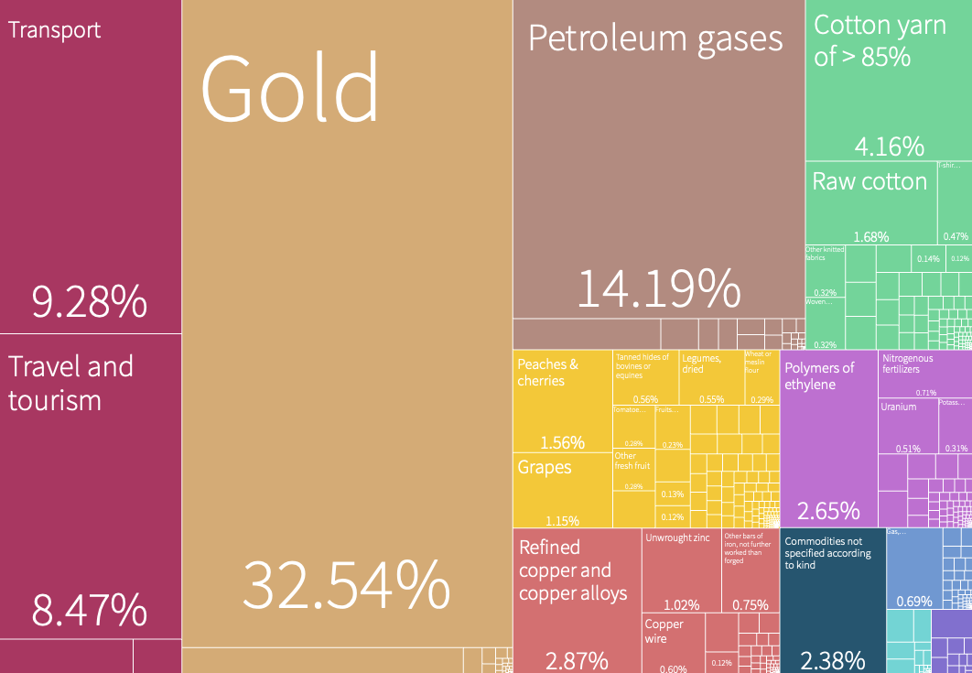
ECI - Visualization
Export of U.S.A. in 2018 (ECI = 1.55)
Export of Uzbekistan in 2018 (ECI = -0.41)
Notes:
We also provide the ECI results and their economic structure of the United States and Uzbekistan. In comparison, the ECI of the United States is indeed higher than the one of Uzbekistan. This was due to the fact that the economic structure of the United States is much more complicated, spanning across products that requires high technology like ICT (information and communication technology) and products that only needs less knowledge, like corn or soya bean cultivation. For Uzbekistan, its economic structure is a bit less comprehensive, which mainly consist of metallurgy and chemicals manufacturing. Therefore, ECI works pretty well in summarizing the economic complexity of a country.

Slide 15
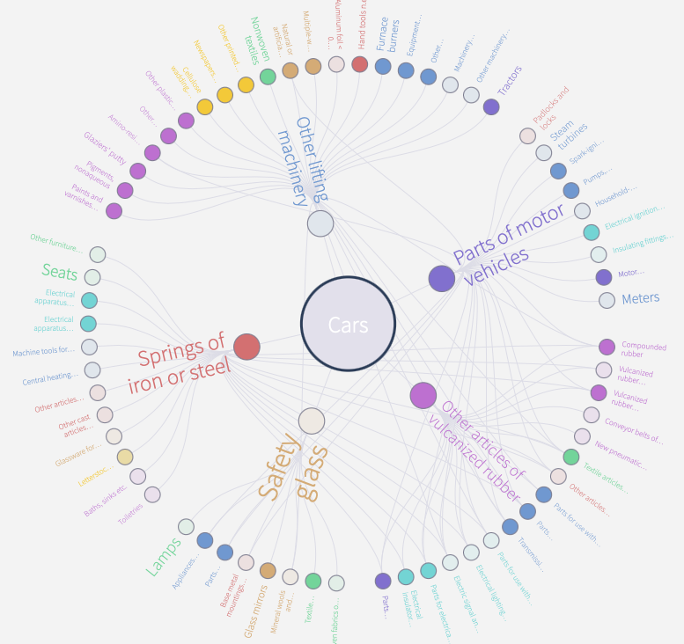
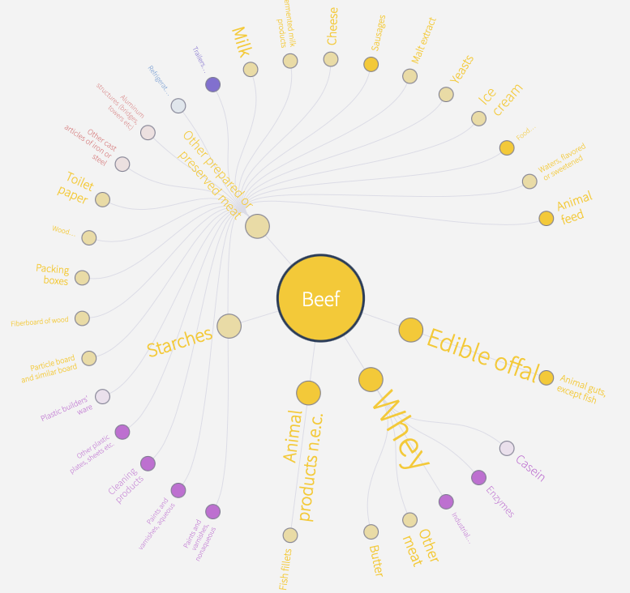
ECI vs PCI
ECI : an index measures the diversity of the products that a country produces. A country produces more products with high ubiquity has a higher value.
PCI: an index measures the knowledge contained in the production of a product. A product with more connections to the production of other products typically has a higher value.
Notes:
There is another related term called PCI, product complexity index. ECI measures the economic complexity of a country’s product space, and PCI measures how many knowledge is required for producing a product. A higher value means that it connects more to the production of other products and requires more resources for production. It is well known that cars have a higher PCI than beef. As shown in the two pictures, we can also observe that cars production indeed has a lot more connections with other products than beef production.

Slide 16
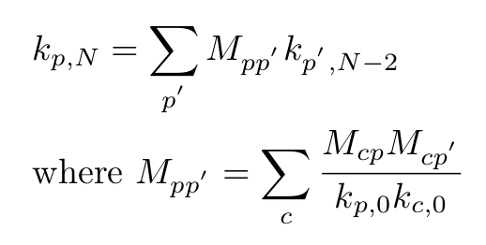
PCI Calculation & Intuition
Modified diversity:
Modified ubiquity:
PCI can be calculated by the standardization of solution of the equation:
Notes:
After we have seen the calculation of ECI, the calculation of PCI is very similar. In order to calculate the final value of the recursive ubiquity, we can solve this implicit equation. And finally the PCI is just the standardization of the solution. This problem is also identical to solve for the eigenvector of the matrix M_{pp’}.

Slide 17

Proximity & Distance Intuition
Products that require similar knowledge → More likely to be exported by a single country
This probability of two products being exported by a country, can be used to define the proximity of industry verticals
Collection of all proximities between industry groups forms a network defined as the product space, as illustrated in next slide
On the other hand, products that are far away from each other in the product space likely require very different skills to produce → Distance
Notes:
For a given economy, certain groups of products will likely require similar skills to develop. For example, the knowledge of manufacturing shirts can easily be applied to pants, but it would be much more difficult to extend the knowledge to manufacturing chemicals. This is the core idea behind the concept of proximity. Products with greater proximity are more likely to be developed by the same country, as countries will generally exploit the existing knowledge base that they have. If we were to collect all proximities between pairs of products, we can use this to build out the product space, which show us a network between various industry groups and their relative proximity to each other. The structure of this product space is incredibly important, as it shows how easy/difficult it is for a country to expand from an existing product to another vertical. Tighter product spaces imply that the country can easily transition from one industry to another. However, if the space is structured such that specific industry groups are clustered, but far from other clusters, it will be difficult for countries to uptake production in new verticals. To quantify this space between industry groups in the product space, we use the metric of distance, which is more formally defined in the next slide.

Slide 18
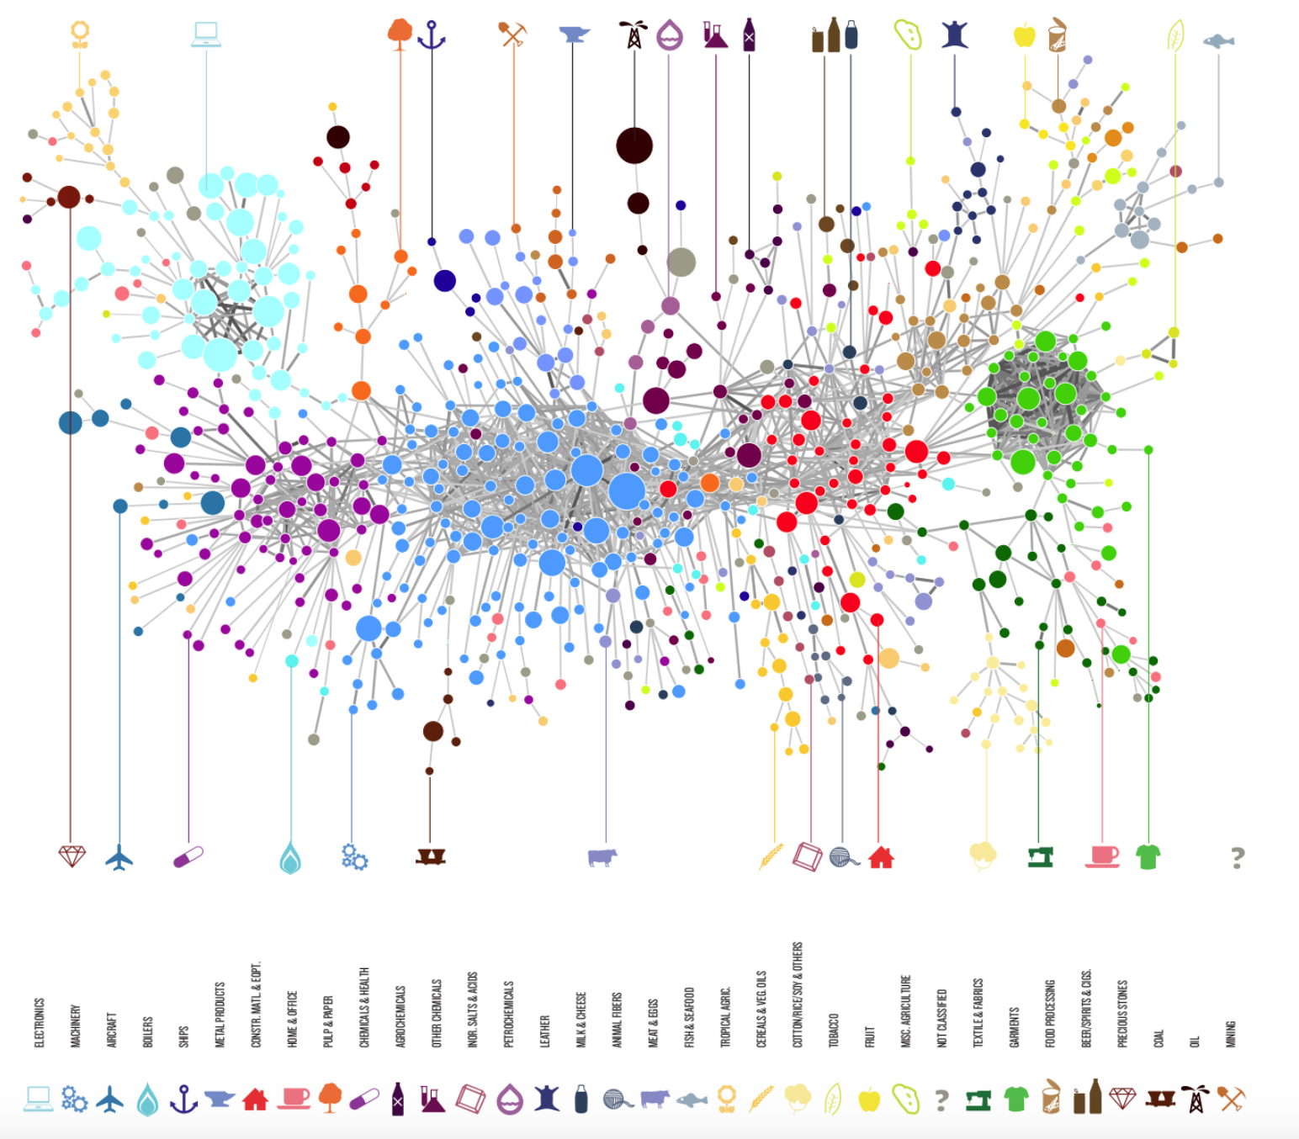
Proximity & Distance Intuition
How can we define proximity between countries or products in the ECI framework
A visualization may be helpful here
Notes:
As seen above, when we plot various industry groups and build a network rooted in their proximity, we arrive at a product space that shows how clustered certain industry groups are for the country in question.
Image obtained from The Atlas of Economic Complexity

Slide 19
Metrics for Proximity & Distance
Formally, proximity is defined as the conditional probability of exporting p₁ given the country produces p₂ and that of exporting p₂ given production of p₁
Similarly, distance is defined as the normalized level of connectedness between a product and all other products in its industry space
Notes:
If we want to formally quantify these metrics, we see that proximity between industry verticals A and B is defined by the probability that a country will export A given it produces B and vice versa. This makes sense, as if items have closer proximity (and therefore closer knowledge required to manufacture), then a country is more likely to participate in the joint production of them.
We can then extrapolate this to distance which is a general measure of a country’s connectedness to a product. Specifically, distance is proportional to how much knowledge a country lacks to produce the product (proximity, on the other hand, is based in the knowledge actually shared among two products by a country). Thus, distance is calculated by the sum of proximities between a particular good and all the goods not being exported by the country normalized by the proximities of all products in the country’s product space. For example, if a country is already producing a lot of goods that are in close proximity to a product A, then the distance to A is small. On the other hand, if the country doesn’t produce many of the goods in close proximity to A, then the distance to A will be large.

Slide 20
Opportunity Gain and the Suggested Development Vector (SDV)
We can define the opportunity gain as being the marginal increase in complex products that a country is exposed to upon taking on the production of a specific product
  Therefore, the opportunity gain for an existing product would be 0
  On the other hand, investments in products that would lead exports in more profitable products to diminish would have a negative opportunity gain ssd
Formally, Opportunity Gain can be defined as the distance decrements in the product space from investing in a given vertical, weighted by their complexity
If we were to rank various products by their opportunity gain on a per country basis, we arrive at the definition of the Suggested Development Vector
Notes:
Just as how distance gives us an idea of how far each new product is from a country’s current mix of exports, we define opportunity gain as being the contribution of a new product in terms of opening up the doors to more and more complex products. In other words, how does an incremental investment in a certain vertical lead to an increase in the complexity of the country’s economy? Intuitively, a product that a country is currently exporting has an opportunity gain of zero. On the other hand, an investment in certain products that would lead to a relative decrease in the export of more profitable products would have a negative opportunity gain. The trade-off being made here is between advancing a new product bringing all products closer to the product space, while also incurring a cost due to the low complexity and huge distance of the product. The Opportunity Gain will go negative if the product is an extreme outlier in the product space, and is loosely connected to other products.
If we rank various verticals based on their opportunity gain for a specific country, we arrive at the Suggested Development Vector (SDV). The SDV shows us which verticals present the biggest opportunity for investment, as well as which verticals will lead to positive and negative opportunity gains.

Slide 21
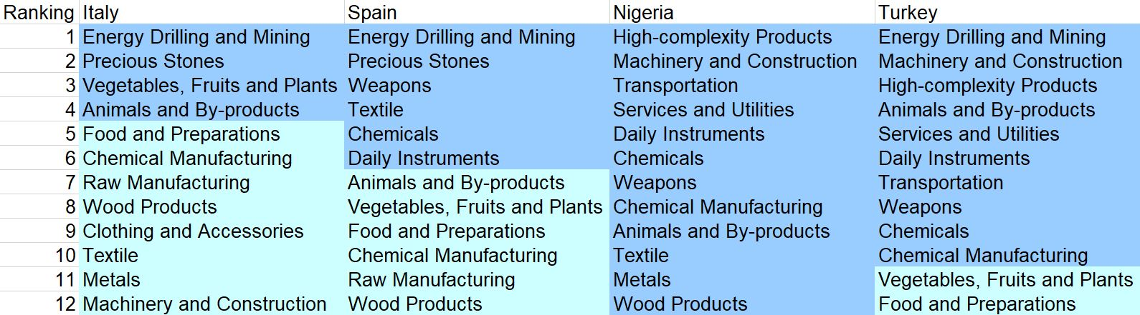
Suggested Development Vector (SDV)
Sectors are ranked based on the opportunity gain of investment in each
On the other hand, we see a much higher count of opportunity gain-positive industries among developing countries such as Nigeria and Turkey, as they have more room to grow out their complexity
Nations such as Italy and Spain, which are more developed and have more complex economies, have fewer opportunity gain-positive industries, as most sectors have already been invested into (small marginal benefit!)
The question then becomes how can we generate a sequential strategy for developing nations to take advantage of high opportunity-gain sectors?
Notes:
Here we summarize the SDV of a couple of countries in the world. As expected, we see that less developed countries such as Nigeria and Algeria tend to have more industries that present a positive opportunity gain (dark green). On the other hand, developed countries such as Italy have a larger balance between positive and negative opportunity gain industries. This also means that they have a more stable and efficient economic structure, as they don’t need to transition between industries to maintain economic development. On the other hand, a country like Nigeria has many different industries that it could invest in to enhance its complexity (almost all except for one).
That being said, it is possible for a developing country to have a balance economic structure, even if their output quantities may be smaller. Similarly, a developed country can also have yet to reach a stable economic structure. However, what this result serves to show is that we can potentially use economic complexity as a macroeconomic indicator, one that not only describes the quantity but quality of economic progress.
The differences in economic structures for developed and developing countries suggests that we need a model for analyzing development at different stages. Is there a sequential strategy that can walk through changes in the SDV and overall structure of an economy as countries invest in specific industries? How can we use this to maximize growth for developing countries? Similarly, for already developed countries, can we use this information to understand how shocks to specific industries can affect development, and what strategy should be adopted by countries in these situations?

Slide 22
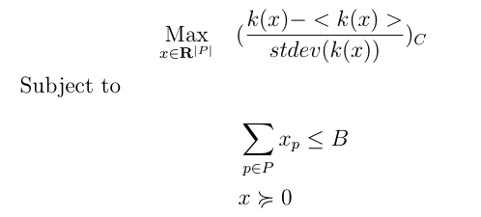
Budgeted Greedy Development Strategy
SDV is a qualitative method, which can be used to uncover products helpful for ECI improvement.
Budgeted Greedy Development Strategy is a static quantitative method, which can be used to solve a budget allocation portfolio to improve ECI.
  Given the budget of investment, we formulate an optimization problem as follows and want to solve for an optimal budget allocation:
where B is the budget, P is the product space, k(x) is the eigenvector associated with the second largest of MCC' after adding x to the original export vector, C is the country we are interested in.
Notes:
SDV is a helpful approach in order to find out potential products to build up a country’s economic structure and improve its ECI. Therefore, it helps us to evaluate whether increasing investment into a certain product would result in an ECI increment. However, it does not tell us how much a country should invest. Also, a common situation is that the budget for investment is usually limited. Therefore, according to this question, we formulate an optimization problem where we want to find out an optimal investment portfolio such that the ECI can be maximized and simultaneously, the budget is limited.

Slide 23
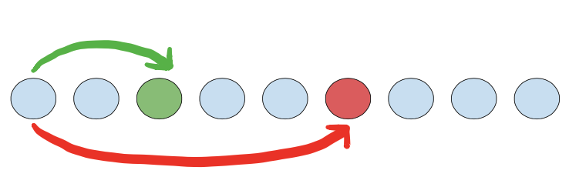
Budgeted Greedy Development Strategy
The problem is hard to solve because it is non-linear and non-convex.
One idea to obtain a near-optimal and feasible solution is to use Greedy Algorithm.
Algorithm abstract:
Divide the budget into multiple parts (shares).
For each part, search for the product that can result in an activation and maximize the current ECI. If there are no activations for all products, we increase one share.
If we find there is an activation, we can still keep looking for the next activation, and calculate the ratio of ECI increment to budget used. This step depends on how many activations we want to foresee.
Notes:
However, this problem is not easy to solve because even though the constraint is linear, the objective involves complicated calculations, and it is even non-linear and non-convex. In order to solve this optimization problem, we develop a new algorithm based on Greedy algorithm. Basically, greedy algorithm is just about choosing a solution that can maximize the objective function at the current point. Therefore, in our cases, we separate the budget into multiple smaller shares. And for each smaller share, we loop through all the products and find out the one that can maximize the ECI increment if we invest this share into this product. Then for each share, we can do the same thing and eventually find out a near-optimal solution. However, it is quite common that a share is not enough for making ECI increase; therefore, we can try to keep adding up multiple shares until we find an increment.
In order to avoid local maximum, we can also keep looking for the next increment, and compare with the two increments by calculating their ratios, which is the ECI change over the budget used. In addition to two increments observation, we can also observe more increments further, but this will also lower the computational efficiency.

Slide 24

Why do we care about sensitivity analysis?
So we’ve created this ECI metric but we haven't built any intuition about its behavior under perturbations.
We’d like to understand how changes in the export data can change a country’s ECI score.
Is the ECI rank of a country very sensitive or insensitive to changes in a particular industry or group of products?
Notes:
The creation and calculation of any quantitative metric warrants the following question: what would happen to the metric if I perturbed the inputs? Understanding the sensitivity of your metric allows an analyst to understand the driving forces beneath the metric itself. An analyst will be able to know which inputs are key in the construction of the metrics and which ones do not affect the final result as much. In our case this is a very useful type of analysis. Sensitivity analysis allow us to answer the fundamental question, which industries are key in driving up the ECI score of a particular economy? Understanding this allow us to see which industries are important for the development strategy of an economy and gives a bit more insight into how we may intelligently design a development strategy that keeps this industry stable.
Sensitivity analysis can also be viewed from the standpoint of risk. Will drawdowns in particular industries cause large shocks to the ECI score? Which events should a country avoid at all costs? Will a 20% drawdown in High Complexity Products affect an economy as much as a 20% drawdown in Manufacturing. Understanding sensitivity and performance metrics allows us to better assess the risk profile of a country. We would like to be able to categorize whether a country has a stable ECI or an unstable ECI score through doing this type of analysis.

Slide 25
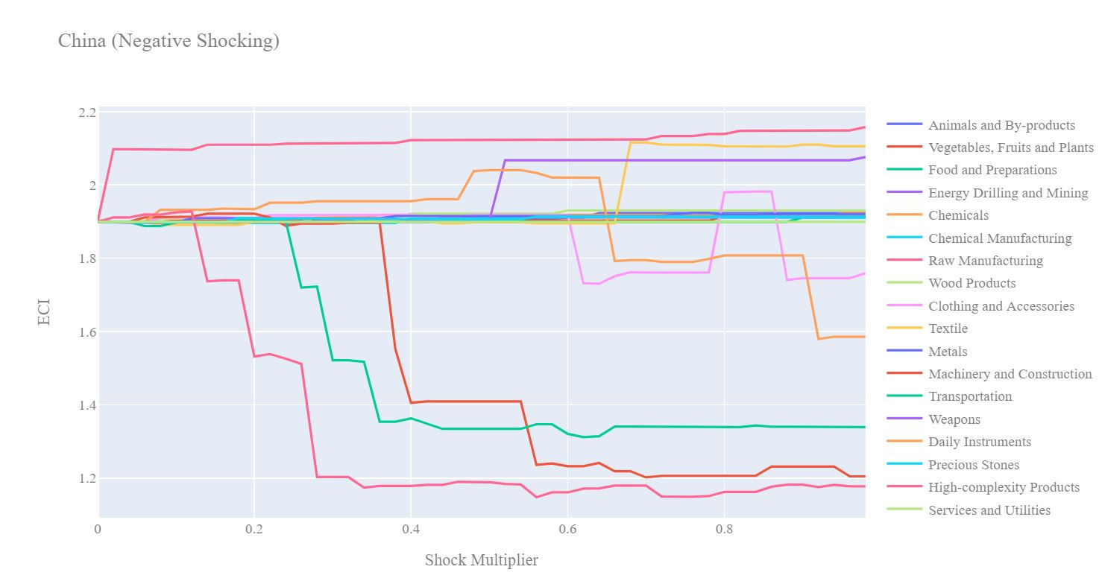
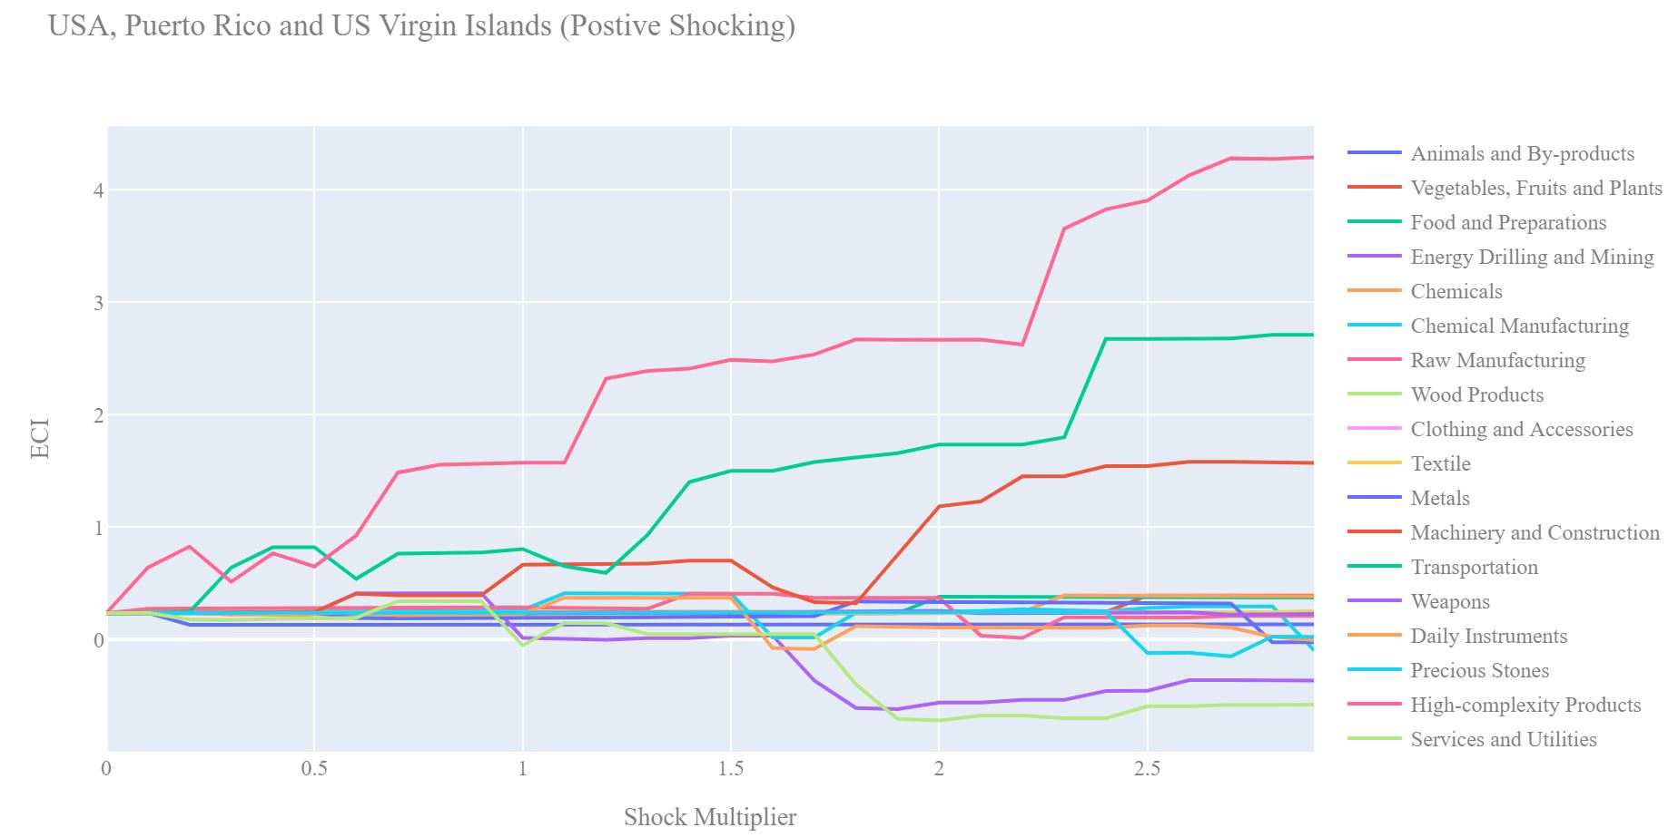
Sensitivity Analysis
The broad aim of the sensitivity analysis section is to understand how sensitive a country is to instantaneous increments or decrements in export levels in various industries
Two areas of analysis:
the stability of a country’s ECI with respect to shocks in underlying export level
the sensitivity of a country’s SDV to changes in export level
ECI Sensitivity Analysis is conducted on all countries while as SDV sensitivity analysis is conducted on developed countries with well-diversified economies.
Notes:
So how do we conduct our sensitivity analysis? We generate two separate charts for each country. In chart one we positively perturb the export data for a particular country for x% at very small increments. In the second chart we negatively perturb the export data for a particular country for x% at very small increments. This allows us to visualize how small drawdowns in an industry may affect the ECI score as well as very large drawdowns. This is done for every industry group for a country. Interestingly, some patterns begin to emerge as we study these sensitivity charts. Firstly you will notice that often a hockey stick or upside down hockey stick shape will occur. This suggests that while an drawdown or increase in export of an industry may lead to an immediate change in ECI score after awhile the ECI sore plateaus and changes in the export level no longer affect the ECI score. In the positive shocking case the interpretation of the corner point of the hockey stick is that this is maximum amount an economy should invest in an economy since after that they will likely experience diminishing returns. Often we also see that decreases in export for certain industries actually increases the ECI score! This suggests that this industry is actually keeping the ECI low and it would be better if that nation did not focus its efforts on expanding that market sector.
Until now all of our sensitivity analysis has been done by in some sense treating each industry independently. Our shocking charts are created based on the assumption that an industry is shocked by x% given that all other industries are held constant. This obviously is far from the economic reality. Modelling the interrelationships between industries would be a challenging task in itself but something that would be worth analyzing.

Slide 26
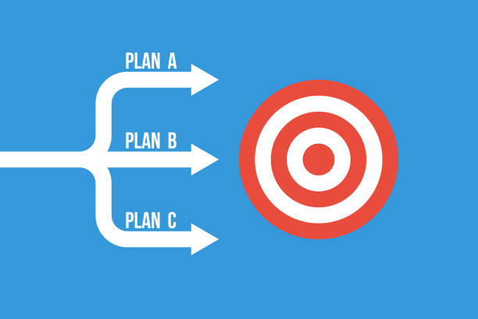
Contingency Strategy
Essential Question: How should a country react to drastic drawdown in exports from a important industry?
When sudden geopolitical, or economic factors cause downturns, through the lens of ECI, we can suggest the industries that are optimal to invest in to maximize a recovery
Intuitively the country should invest stimulative capital into industries that will “open as many doors as possible” into even more promising industries.
Notes:
All economies must be prepared for the worst case scenario in which, geopolitical disasters, natural disasters, etc. completely destabilize the entire economic system. In situation like that countries must be at the ready with a strategy for recovery. Using the ECI framework we are able to suggest the optimal blend of industries that would lead to the fastest ECI growth and thus economic recovery.
We conduct this analysis by shocking the export data down by 60% for all key industries of a country. Then we can recompute the Suggest Development Vector(SDV) for each economy and output the top three industries that would lead to the largest opportunity gain. The idea is that these industries would be the best for an economy to invest in and subsidize in a disastrous scenario so that a recovery can be achieved in the smallest amount of time.

Slide 27

SOI
How do we measure the effectiveness of our suggested development vector?
We define the Structural Optimality Index (SOI) as the R-Square obtained from regressing the country’s actual development over the suggested development strategy.
Actual development is quantified in terms of the export increase in major industry groups, and suggested development is represented by the opportunity gain of developing in specific groups, as previously calculated
This gives us a way of quantifying how the actual path of development adopted by a country lines up with the suggested path that we uncovered
Notes:
Our Suggested Development Vector is a strong roadmap as to how countries can improve their growth using ECI, but the question remains how effective this strategy is when compared to the country’s existing development strategy. To address this, we introduce the Structural Optimality Index (SOI), as being the R-square coefficient between a country’s realized development path and the suggested development vector.
Similar to SDV, we calculate actual development based on the marginal export increase in specified industry groups. This is very similar to the suggested development vector, which is also a marginal gain from developing in specific groups as per the ECI. In doing so, we are able to obtain a metric that extends our theoretical analysis to one rooted in the country’s actual development. A higher SOI is indicative of a higher degree of correlation between our suggested path and a country’s actual development.

Slide 28
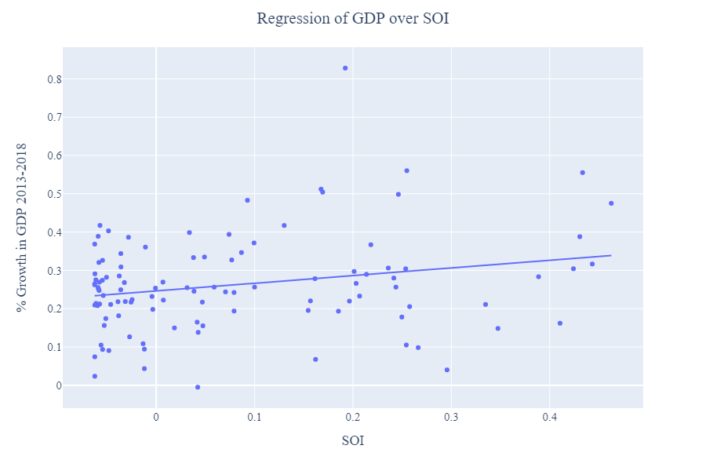
Comparing ECI with other Macroeconomic Metrics
We also want to understand how well ECI lines up with existing Macroeconomic metrics
Solution: Regress SOI with other Macroeconomic metrics!
In fact, when we regressed net increase in GDP over 5 years with the SOI, we achieved a strong positive correlation that was significant at a 1% level
This shows that development based in complexity translates over to increases in GDP
Notes:
Because SOI is defined by a country’s real output, it can be used as a macroeconomic metric for countries. To show this, we compared SOI with other macroeconomic indicators, such as GDP. In fact, after regressing SOI with the 5 year net increase in GDP for 106 different countries, we obtained a strong positive correlation, significant at the 1% level. Not only does this show that SOI can be used as an accurate macroeconomic metric, but it is also important as it proves our hypothesis that the more a country develops as suggested by calculations on a complexity level, the better economic outcomes it will achieve. In other words, ECI-based development can translate over to increases in GDP. By following a strategy outlined in the SDV, not only will countries enhance their complexity, but they will be able to achieve higher levels of economic output as measured by GDP.

Slide 29

The Limitations of the ECI framework
Q1: Does export data fully capture the knowledge that is embedded in an economic system?
ECI truly tries to measure the capabilities that an economy has in aggregate, but they are, by definition intangible. The ECI solution is to proxy knowledge with the complexity of products, however services that a country provides also carries information about the knowledge embedded in an economy. Unfortunately the data only reflects exports of tangible products.
Q2: Does the binary definition of the Mcp matrix introduce a limitation in the analysis?
The way in which we define the Mcp matrix is by denoting whether a country has or does not have a relative comparative advantage in the export of a product. The binary nature of this measure in some sense throws away much of the information we collect from the export data set. While it is useful in terms of defining an adjacency matrix of a graph, we may be able to get further insights if we loosen this restriction.
Notes:
While the ECI framework brings with it an entire new quantitative methods of analyzing economic systems, there are a few very obvious limitations that would be great to address in later developments. Firstly, as explained previously, the ECI metric uses products that an economy produces as a proxy for knowledge. The more diverse personbytes of knowledge contained in an economy, the more complex the products an economy can produce. The problem is that tangible products are not the only outputs of a well developed economy. Services are often a large part of the export of a particular country however we do not have a good data source that includes the export of services. Thus we may be missing a large part of the capacity of an economy since we have no way of measuring the complexity that comes from non tangible products.
The second limitation of the framework is the design of the Mcp matrix. Remember the Mcp matrix defines whether a country has a relative comparative advantage in a matrix industry or not. In essence each entry is a binary variable. While this has nice interpretation in terms of adjacency matrices of a graph, it imposes restrictions on our analysis that could be avoided. In some sense whether or not a country is successfully engaging in a particular industry cannot be sufficiently reflected in a binary measure. We need to more informative measure to define a relative comparative advantage. However then we loose the interpretation of a 1 representing an edge between the country and product in our bipartite graph. Some mathematical analysis needs to be done to make this change commensurate with the ECI computation.

Slide 30
ECI Possible Improvements
Idea 1: Convert to a continuous scale for the Mcp matrix.
While moving away from the binary nature of the Mcp matrix seems like an interesting avenue, understanding its implications in the rest of the mathematics that is done to compute the ECI score is not trivial. Some theoretical issues needs to be considered in terms of tractability in order to show that conversion to a continuous scale results in a sensible metric. The authors of the ECI+ paper explore this issue and create a new metric they call ECI+
Idea 2: Can we model interactions between countries within the context of ECI?
All of our analysis on a particular country is done independent of all other countries. In some sense we freeze all other countries as we analyze a particular one. Obviously in the context of sensitivity analysis, suggested development, etc. this is unrealistic. How countries evolve may impact the development of other countries. Finding an intelligent way to include this idea in our analysis may make our results far more realistic.
Notes:
As we noted in the previous slide, converting the Mcp matrix into a continuous scale would in fact make our analysis much more expressive and allow us to squeeze more value out of the data that we are collecting. Again theoretically we are unsure if this is tractable but it is something that other teams have looked into. Most notably a recent paper on ECI+ seems to address the binary nature of the Mcp matrix.
Finally, throughout this analysis we have thought of countries as independent entities that are unaffected by the actions of other countries. This of course is a massive oversimplification. We believe that the biggest improvements to the ECI framework could be made if we were able to somehow incorporate the relationships between countries into our analysis to further understand how interactions between countries affect their ECI score. This type of augmentation could be useful in our greedy development strategy or our sensitivity analysis. In fact this may be an interesting application of game theory.

Slide 31
https://kachanilab.ieor.columbia.edu/
2021

Slide 32
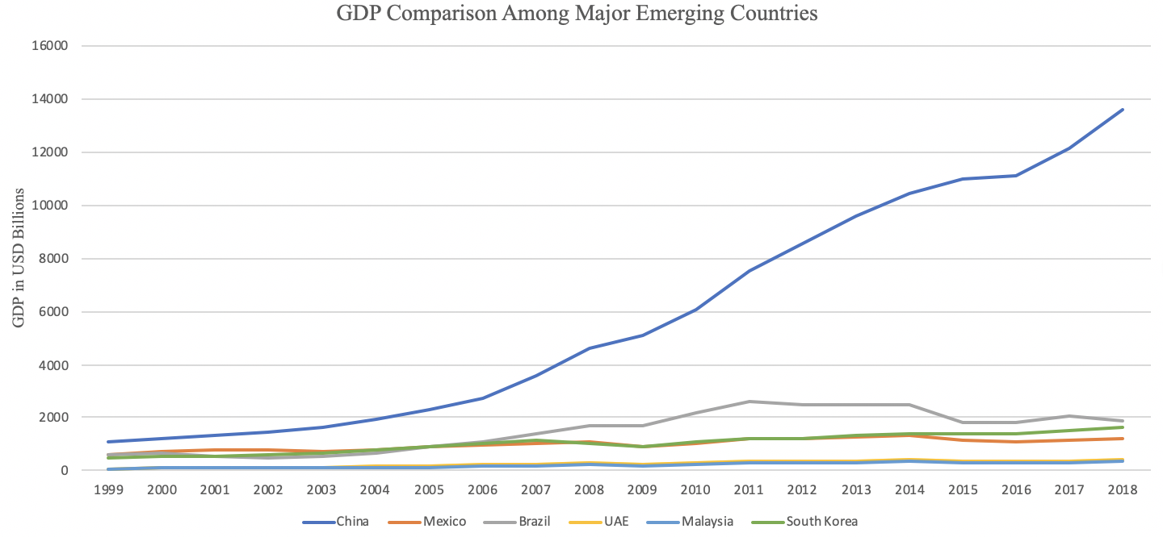
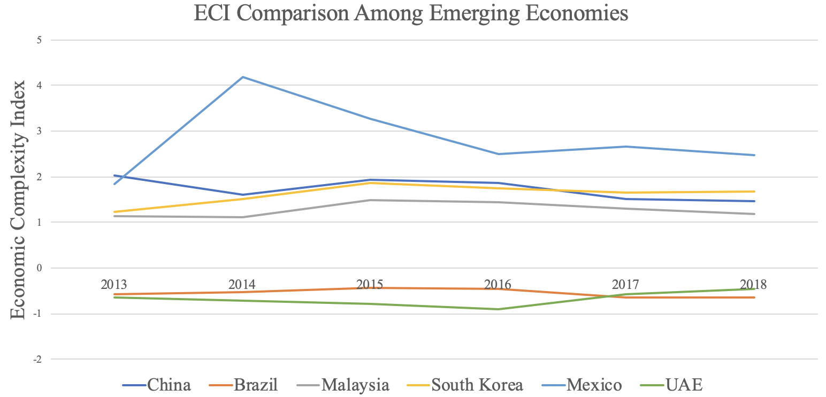
6.1.1 Brazil
 | [CHART ECI Trend] | Macroeconomic Results: GDP PPP 2013: 2.47 trillion GDP PPP 2018: 1.87 trillion GDP Growth over period: -24%
[TABLE RID]

Slide 33
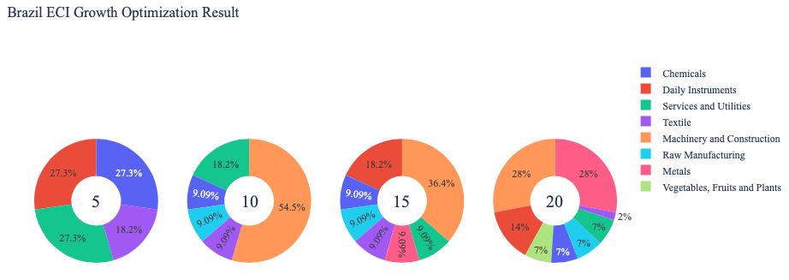
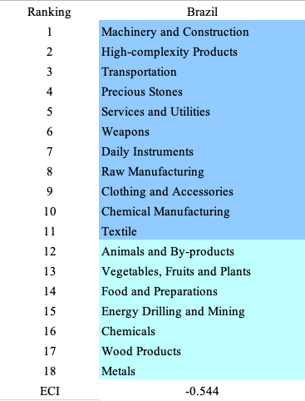
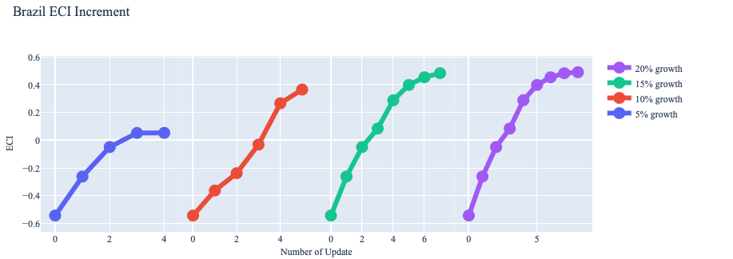
6.1.2 Brazil
[CHART Vision Enhanced Greedy Optimization, ECI Growth] |  | [TABLE Suggested Development Vector]

Slide 34
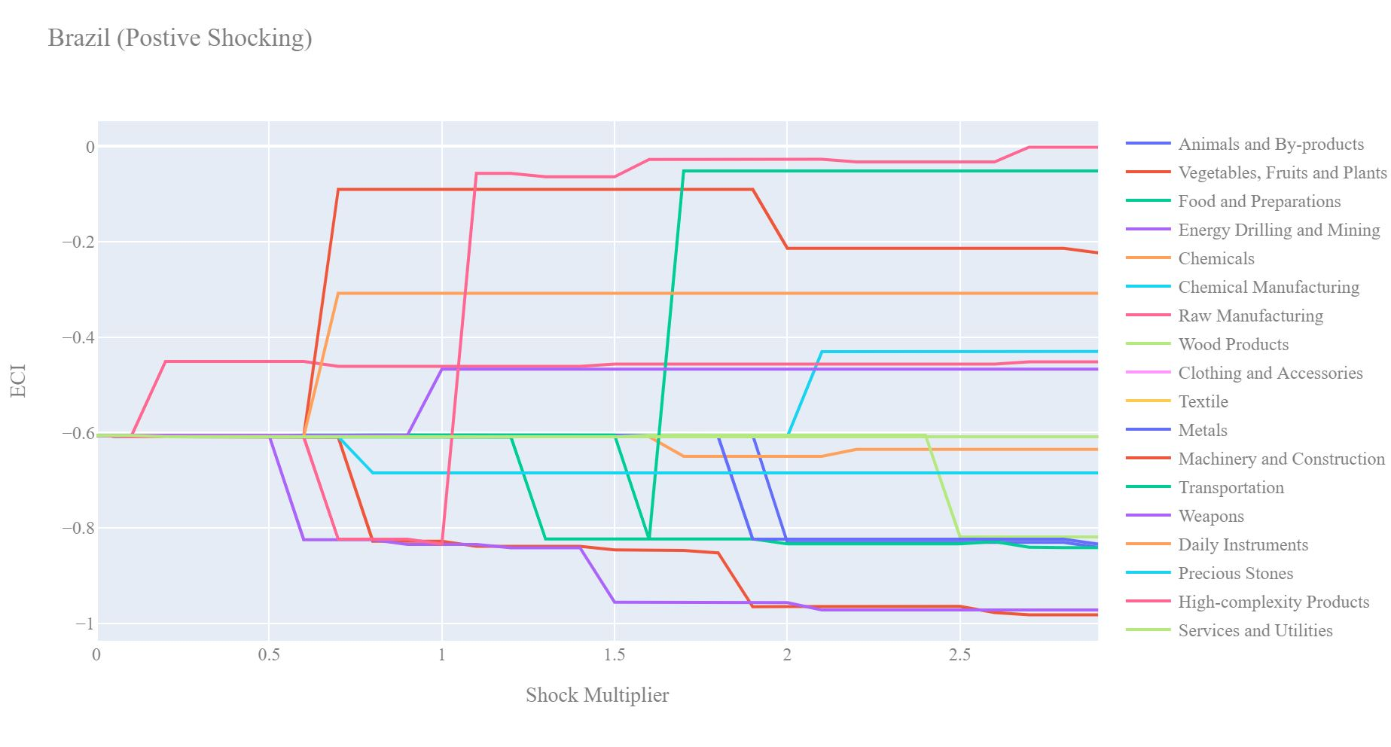
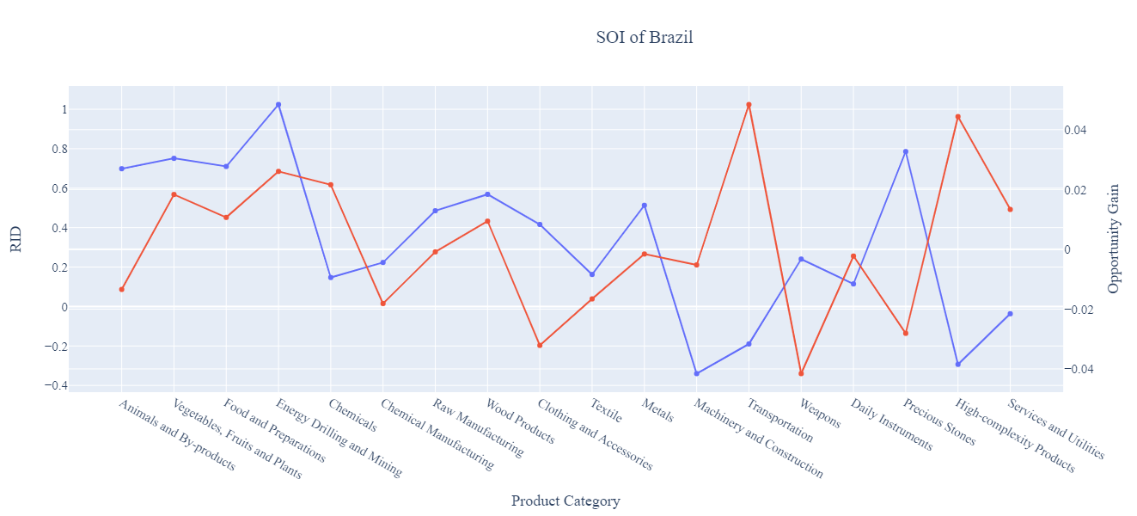
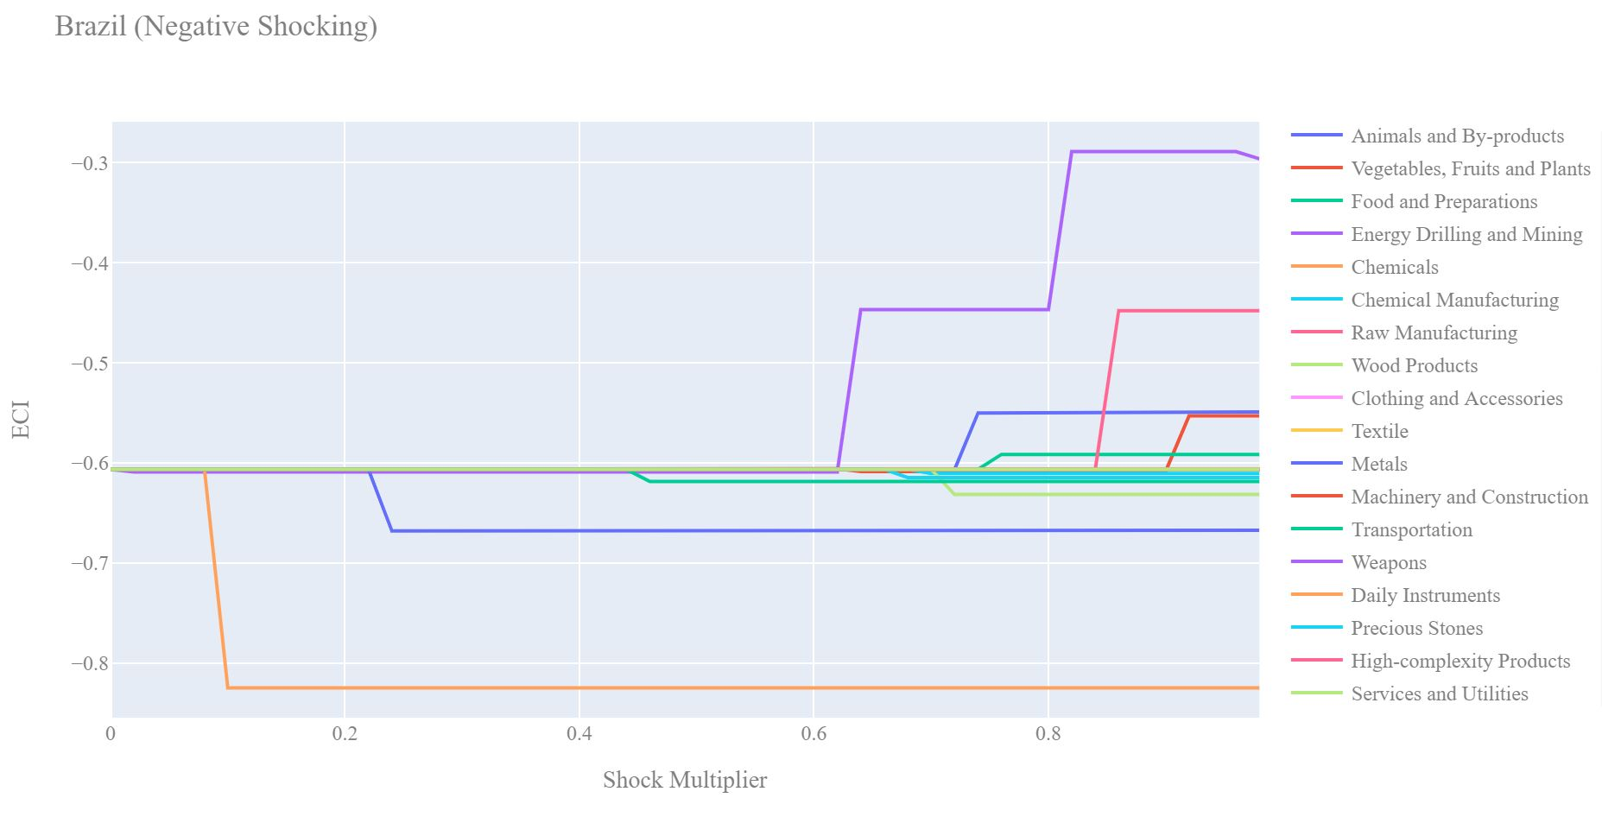
6.1.3 Brazil
RID - Red
Opp Gain - Blue

Slide 35
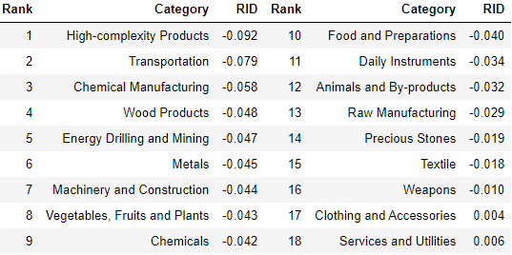
6.2.1 China
[CHART GDP GROWTH] | [CHART ECI Trend] | Macroeconomic Results: GDP PPP 2013: 9.57 trillion GDP PPP 2018: 13.6 trillion GDP Growth over period: 42.2%
[TABLE RID]

Slide 36
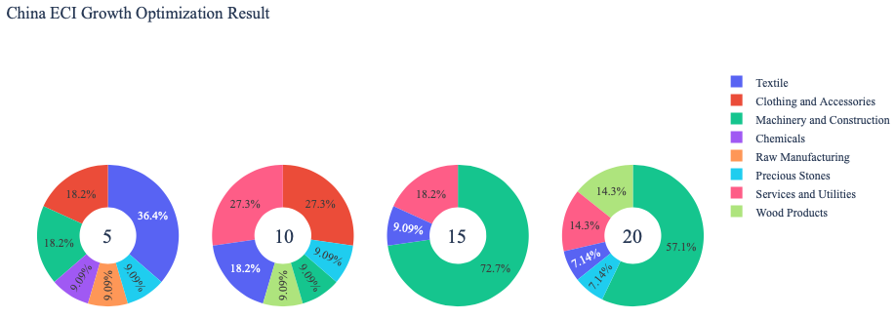
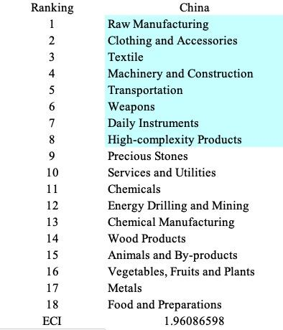
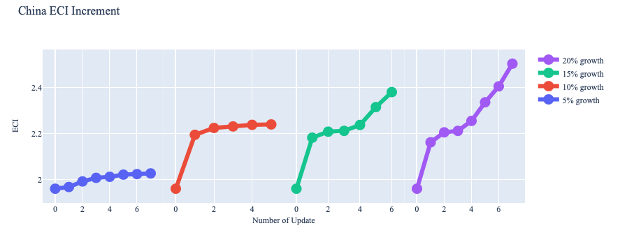
6.2.2 China
[CHART Vision Enhanced Greedy Optimization, ECI Growth] |  | [TABLE Suggested Development Vector]
[CHART Vision Enhanced Greedy Optimization, ECI]

Slide 37
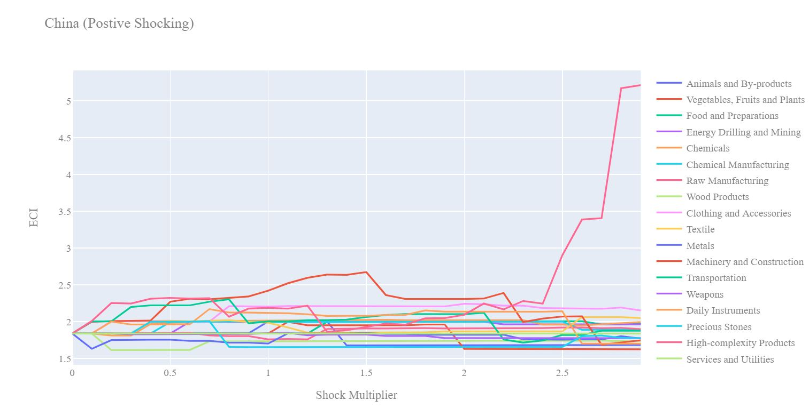
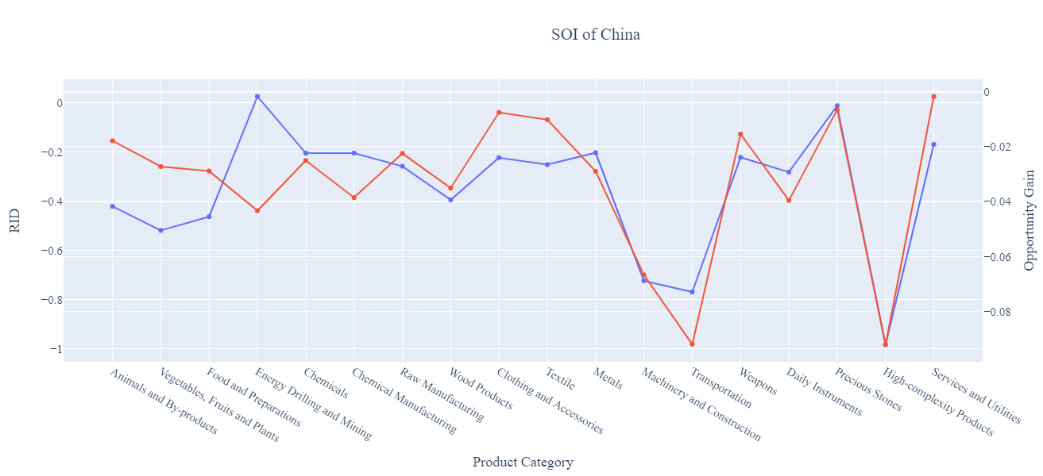
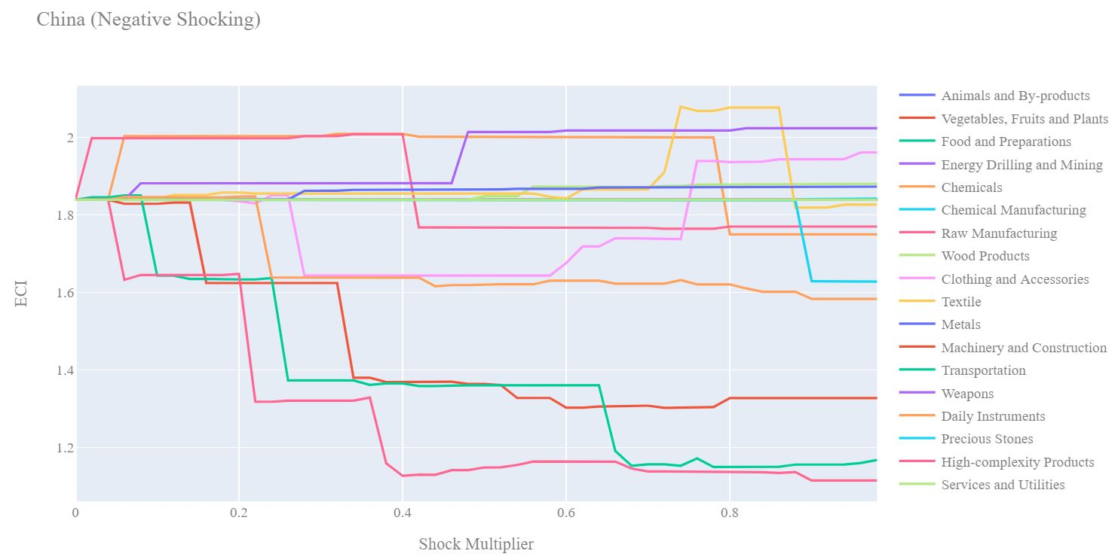
6.2.3 China
[CHART Incremental ECI Sensitivity]
[CHART Decremental ECI Sensitivity]
RID - Red
Opp Gain - Blue

Slide 38
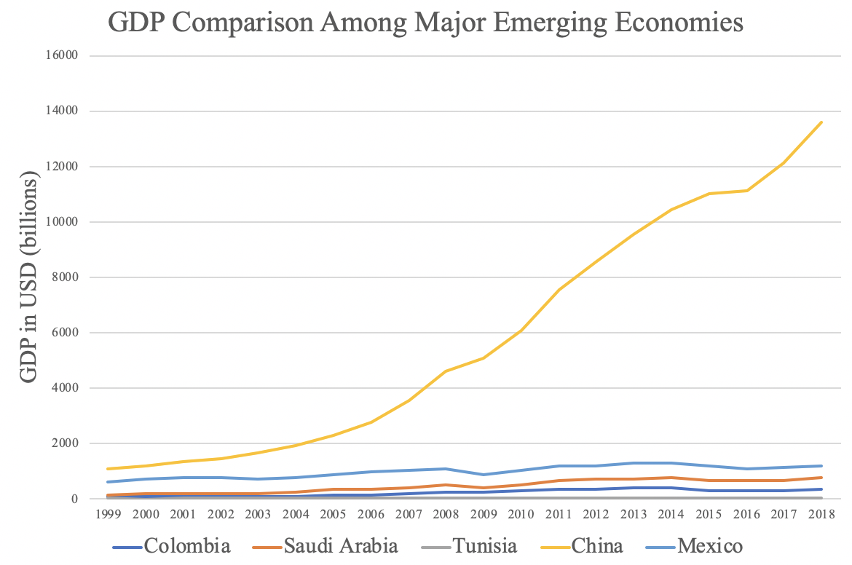
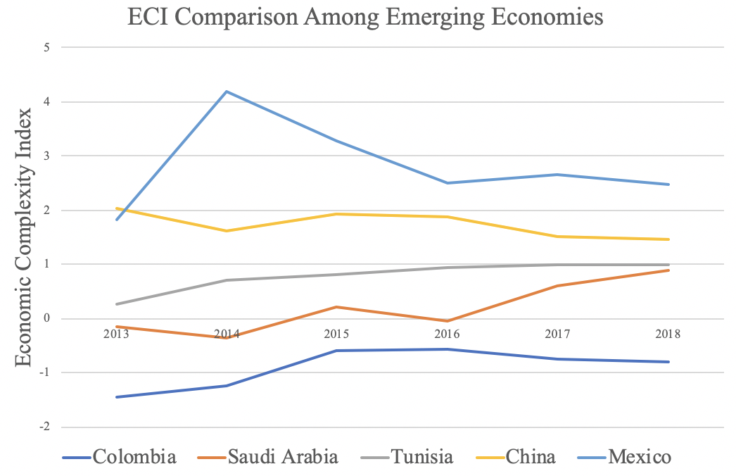
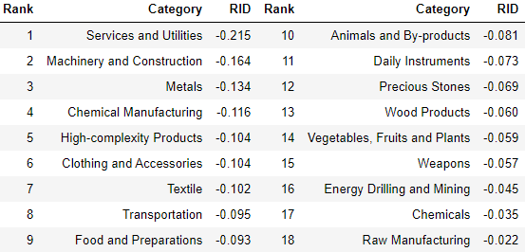
6.3.1 Colombia
[CHART GDP GROWTH] | [CHART ECI Trend] | Macroeconomic Results: GDP PPP 2013: 381 million GDP PPP 2018: 331 million GDP Growth over period: -13%
[TABLE RID]

Slide 39
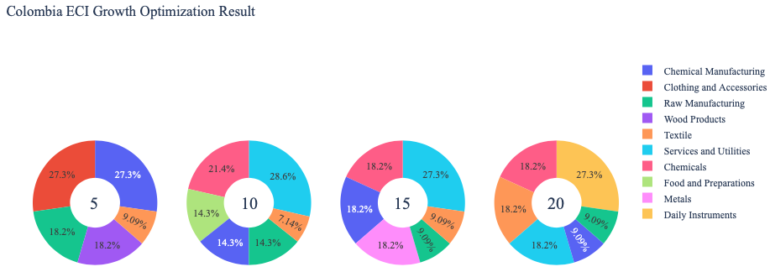
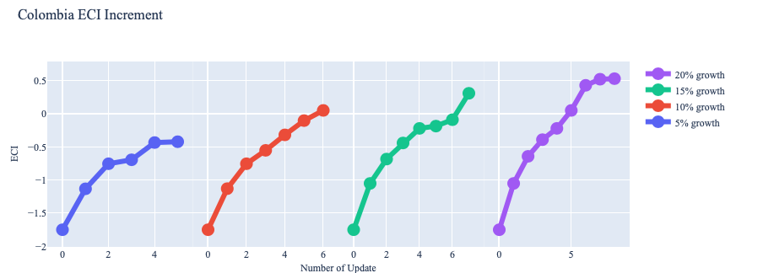
6.3.2 Colombia
[CHART Vision Enhanced Greedy Optimization, ECI Growth] |  | [TABLE Suggested Development Vector]
[CHART Vision Enhanced Greedy Optimization, ECI Increment]

Slide 40
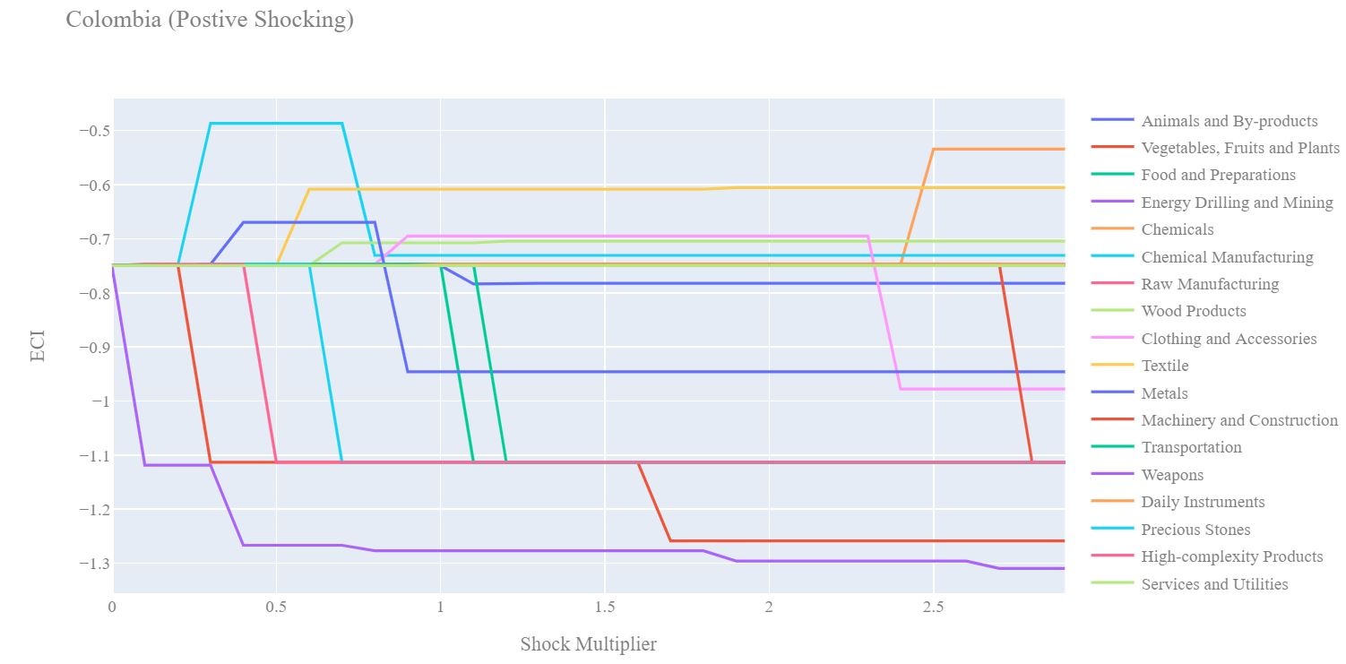
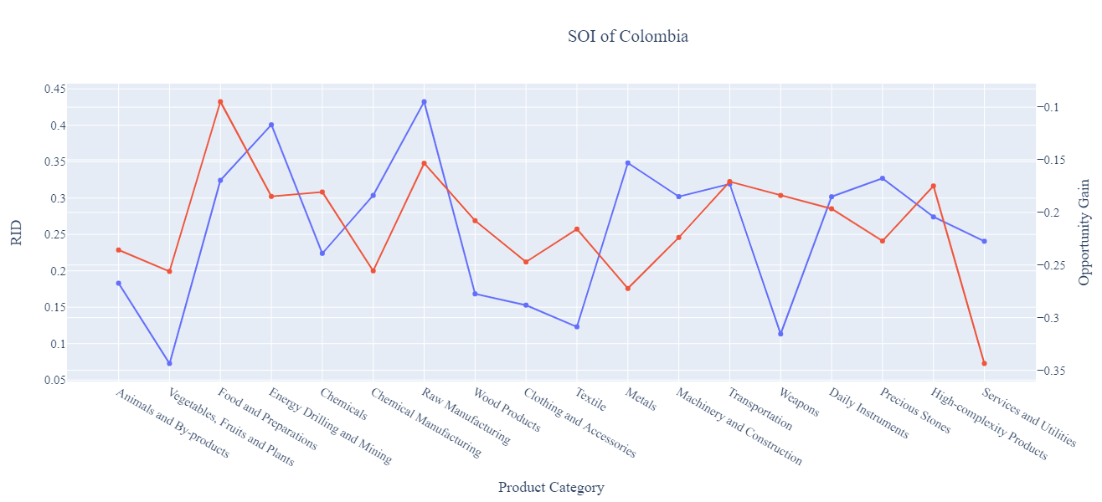
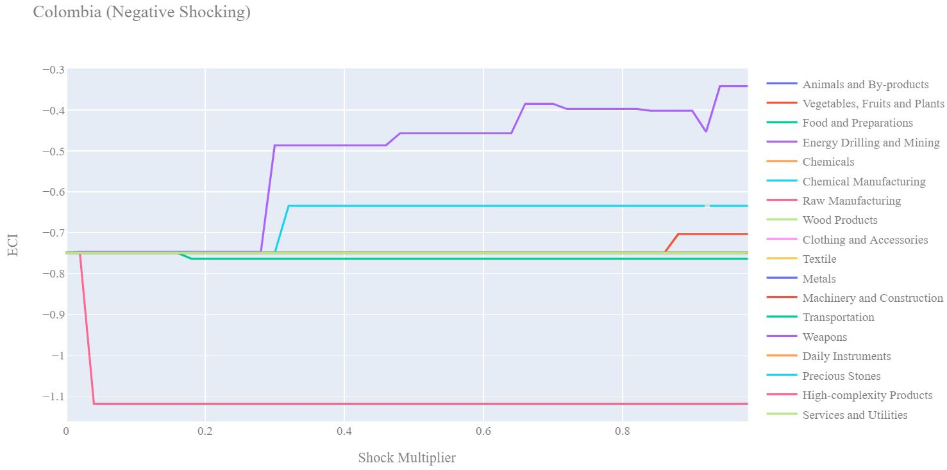
6.3.3 Colombia
[CHART Incremental ECI Sensitivity]
[CHART Decremental ECI Sensitivity]
RID - Red
Opp Gain - Blue

Slide 41
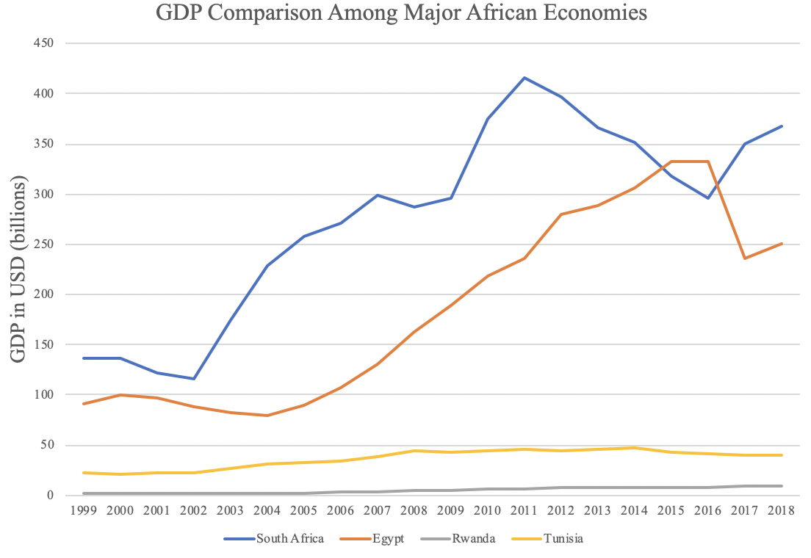
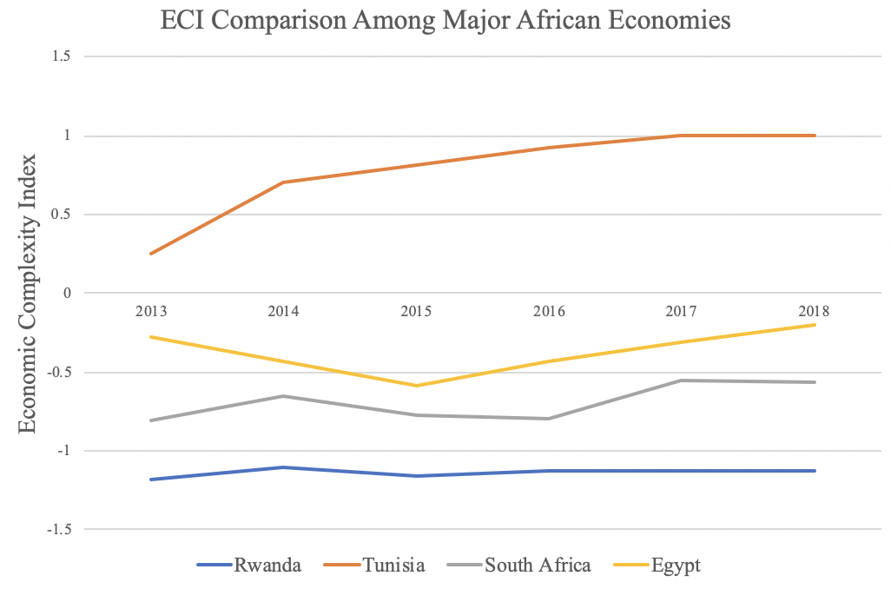
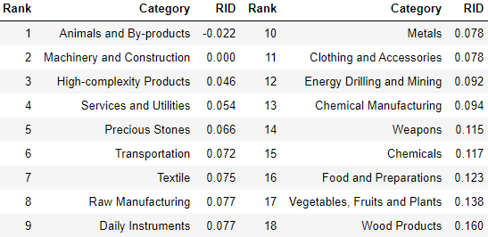
6.4.1 Egypt
[CHART GDP GROWTH] | [CHART ECI Trend] | Macroeconomic Results: GDP PPP 2013: 285 million GDP PPP 2018: 250 million GDP Growth over period: -13%
[TABLE RID]

Slide 42
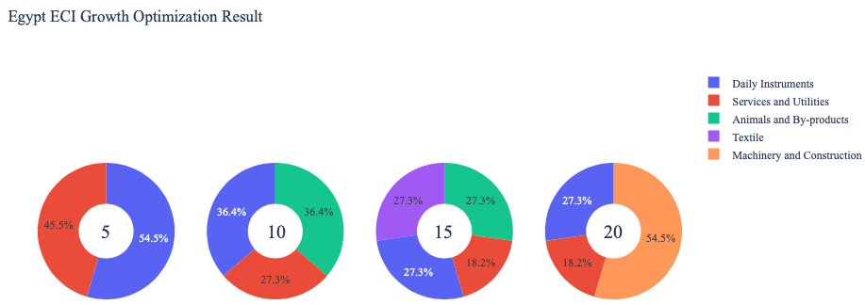
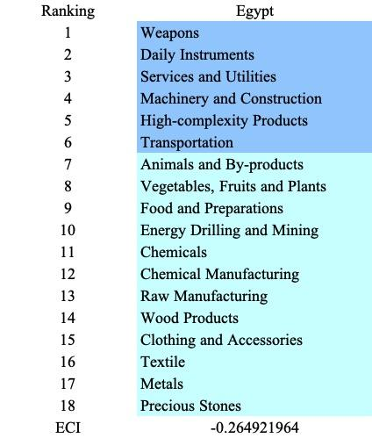
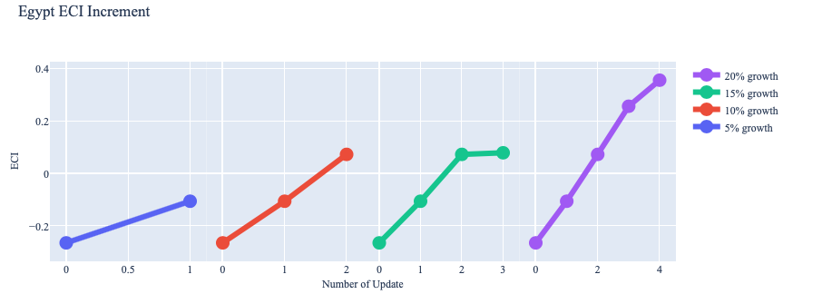
6.4.2 Egypt
[CHART Vision Enhanced Greedy Optimization, ECI Growth] |  | [TABLE Suggested Development Vector]
[CHART Vision Enhanced Greedy Optimization, ECI Increment]

Slide 43
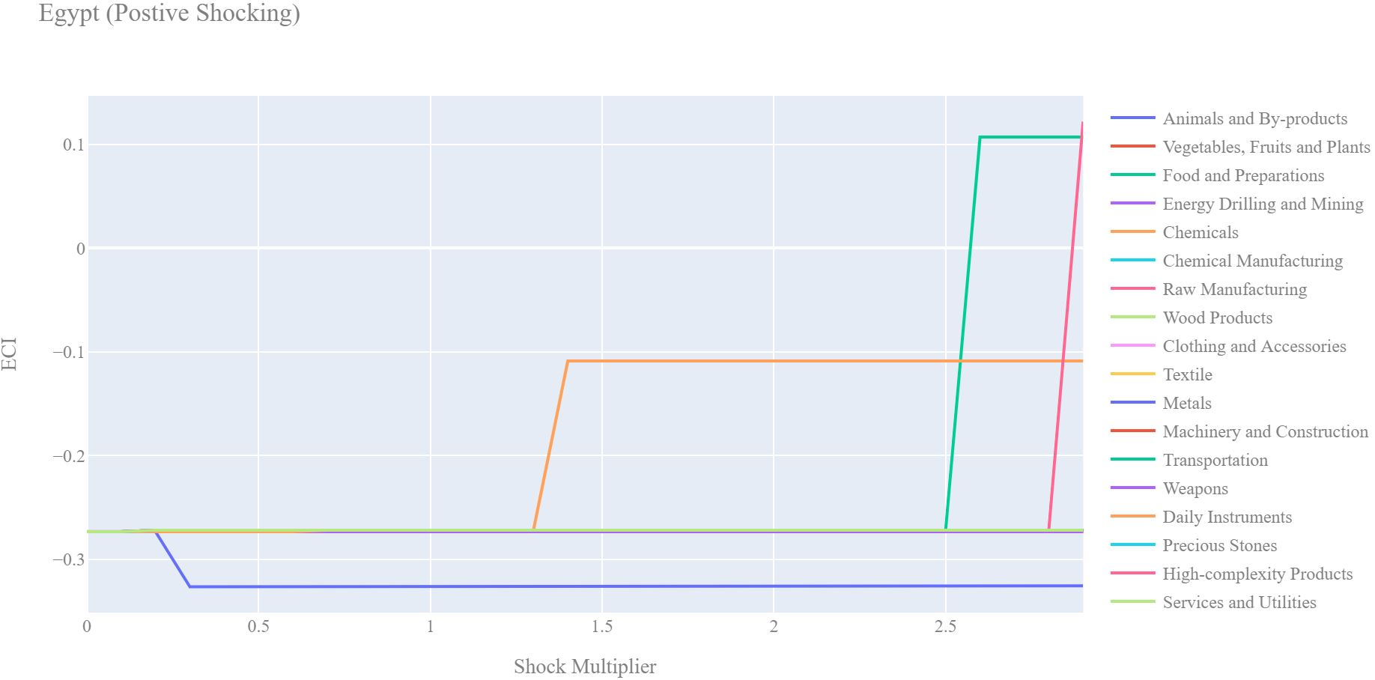
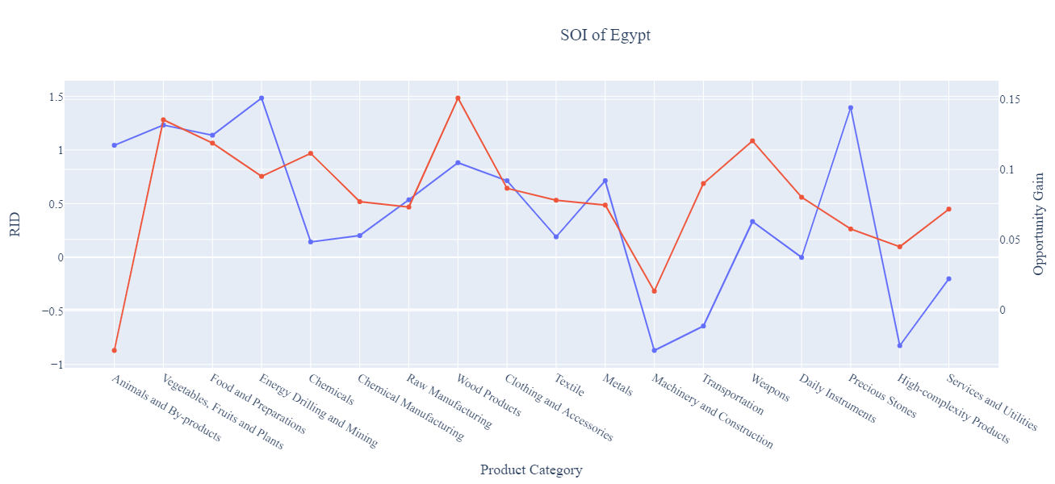

6.4.3 Egypt
[CHART Incremental ECI Sensitivity]
[CHART Decremental ECI Sensitivity]
RID - Red
Opp Gain - Blue

Slide 44
6.5.1 France
[CHART GDP GROWTH] | [CHART ECI Trend] | Macroeconomic Results: GDP PPP 2013: 2.8 trillion GDP PPP 2018: 2.77 trillion GDP Growth over period: -1.2%
[TABLE RID]

Slide 45


6.5.2 France
[CHART Vision Enhanced Greedy Optimization, ECI Growth] |  | [TABLE Suggested Development Vector]
[CHART Vision Enhanced Greedy Optimization, ECI Increment]

Slide 46


6.5.3 France
[CHART Incremental ECI Sensitivity]
[CHART Decremental ECI Sensitivity]
RID - Red
Opp Gain - Blue

Slide 47
6.6.1 Germany
[CHART GDP GROWTH] | [CHART ECI Trend] | Macroeconomic Results: GDP PPP 2013: 3.7 trillion GDP PPP 2018: 3.9 trillion GDP Growth over period: 5.8%
[TABLE RID]

Slide 48


6.6.2 Germany
[CHART Vision Enhanced Greedy Optimization, ECI Growth] |  | [TABLE Suggested Development Vector]
[CHART Vision Enhanced Greedy Optimization, ECI Increment]

Slide 49



6.6.3 Germany
[CHART Incremental ECI Sensitivity]
[CHART Decremental ECI Sensitivity]
RID - Red
Opp Gain - Blue

Slide 50

6.7.1 Greece
[CHART GDP GROWTH] | [CHART ECI Trend] | Macroeconomic Results: GDP PPP 2013: 239 million GDP PPP 2018: 218 million GDP Growth over period: -9%
[TABLE RID]

Slide 51

6.7.2 Greece
[CHART Vision Enhanced Greedy Optimization, ECI Growth] |  | [TABLE Suggested Development Vector]
[CHART Vision Enhanced Greedy Optimization, ECI Increment]

Slide 52


6.7.3 Greece
[CHART Incremental ECI Sensitivity]
[CHART Decremental ECI Sensitivity]
RID - Red
Opp Gain - Blue

Slide 53


6.8.1 Indonesia
[CHART GDP GROWTH] | [CHART ECI Trend] | Macroeconomic Results: GDP PPP 2013: 912 million GDP PPP 2018: 1042 million GDP Growth over period: 14.2%
[TABLE RID]

Slide 54


6.8.2 Indonesia
[CHART Vision Enhanced Greedy Optimization, ECI Growth] |  | [TABLE Suggested Development Vector]
[CHART Vision Enhanced Greedy Optimization, ECI Increment]

Slide 55


6.8.3 Indonesia
[CHART Incremental ECI Sensitivity]
[CHART Decremental ECI Sensitivity]
RID - Red
Opp Gain - Blue

Slide 56

6.9.1 Italy
[CHART GDP GROWTH] | [CHART ECI Trend] | Macroeconomic Results: GDP PPP 2013: 2.1 trillion GDP PPP 2018: 2.08 trillion GDP Growth over period: -2.7%
[TABLE RID]

Slide 57



6.9.2 Italy
[CHART Vision Enhanced Greedy Optimization, ECI Growth] |  | [TABLE Suggested Development Vector]
[CHART Vision Enhanced Greedy Optimization, ECI Increment]

Slide 58


6.9.3 Italy
[CHART Incremental ECI Sensitivity]
[CHART Decremental ECI Sensitivity]
RID - Red
Opp Gain - Blue

Slide 59

6.10.1 Japan
[CHART GDP GROWTH] | [CHART ECI Trend] | Macroeconomic Results: GDP PPP 2013: 5.1 trillion GDP PPP 2018: 4.9 trillion GDP Growth over period: -3.6%
[TABLE RID]

Slide 60



6.10.2 Japan
[CHART Vision Enhanced Greedy Optimization, ECI Growth] |  | [TABLE Suggested Development Vector]
[CHART Vision Enhanced Greedy Optimization, ECI Increment]

Slide 61


6.10.3 Japan
[CHART Incremental ECI Sensitivity]
[CHART Decremental ECI Sensitivity]
RID - Red
Opp Gain - Blue

Slide 62

6.11.1 Malaysia
[CHART GDP GROWTH] | [CHART ECI Trend] | Macroeconomic Results: GDP PPP 2013: 323 million GDP PPP 2018: 358 million GDP Growth over period: 10.9%
[TABLE RID]

Slide 63


6.11.2 Malaysia
[CHART Vision Enhanced Greedy Optimization, ECI Growth] |  | [TABLE Suggested Development Vector]
[CHART Vision Enhanced Greedy Optimization, ECI Increment]

Slide 64



6.11.3 Malaysia
[CHART Incremental ECI Sensitivity]
[CHART Decremental ECI Sensitivity]
RID - Red
Opp Gain - Blue

Slide 65

6.12.1 Mexico
[CHART GDP GROWTH] | [CHART ECI Trend] | Macroeconomic Results: GDP PPP 2013: 1.27 trillion GDP PPP 2018: 1.22 trillion GDP Growth over period: -4%
[TABLE RID]

Slide 66


6.12.2 Mexico
[CHART Vision Enhanced Greedy Optimization, ECI Growth] |  | [TABLE Suggested Development Vector]
[CHART Vision Enhanced Greedy Optimization, ECI Increment]

Slide 67

6.12.3 Mexico
[CHART Incremental ECI Sensitivity]
[CHART Decremental ECI Sensitivity]
RID - Red
Opp Gain - Blue

Slide 68


6.13.1 Morocco
[CHART GDP GROWTH] | [CHART ECI Trend] | Macroeconomic Results: GDP PPP 2013: 106 million GDP PPP 2018: 117 million GDP Growth over period: 10.4%
[TABLE RID]

Slide 69
6.13.2 Morocco
[CHART Vision Enhanced Greedy Optimization, ECI Growth] |  | [TABLE Suggested Development Vector]
[CHART Vision Enhanced Greedy Optimization, ECI Increment]

Slide 70



6.13.3 Morocco
[CHART Incremental ECI Sensitivity]
[CHART Decremental ECI Sensitivity]
RID - Red
Opp Gain - Blue

Slide 71

6.14.1 Poland
[CHART GDP GROWTH] | [CHART ECI Trend] | Macroeconomic Results: GDP PPP 2013: 524 million GDP PPP 2018: 585 million GDP Growth over period: 11.7%
[TABLE RID]

Slide 72


6.14.2 Poland
[CHART Vision Enhanced Greedy Optimization, ECI Growth] |  | [TABLE Suggested Development Vector]
[CHART Vision Enhanced Greedy Optimization, ECI Increment]

Slide 73



6.14.3 Poland
[CHART Incremental ECI Sensitivity]
[CHART Decremental ECI Sensitivity]
RID - Red
Opp Gain - Blue

Slide 74
6.15.1 Portugal
[CHART GDP GROWTH] | [CHART ECI Trend] | Macroeconomic Results: GDP PPP 2013: 226 million GDP PPP 2018: 240 million GDP Growth over period: 6%
[TABLE RID]

Slide 75



6.15.2 Portugal
[CHART Vision Enhanced Greedy Optimization, ECI Growth] |  | [TABLE Suggested Development Vector]
[CHART Vision Enhanced Greedy Optimization, ECI Increment]

Slide 76


6.15.3 Portugal
[CHART Incremental ECI Sensitivity]
[CHART Decremental ECI Sensitivity]
RID - Red
Opp Gain - Blue

Slide 77
6.16.1 Saudi Arabia
[CHART GDP GROWTH] | [CHART ECI Trend] | Macroeconomic Results: GDP PPP 2013: 746 million GDP PPP 2018: 786 million GDP Growth over period: 5%
[TABLE RID]

Slide 78



6.16.2 Saudi Arabia
[CHART Vision Enhanced Greedy Optimization, ECI Growth]
[CHART Vision Enhanced Greedy Optimization, ECI Increment]

Slide 79


6.16.3 Saudi Arabia
[CHART Incremental ECI Sensitivity]
[CHART Decremental ECI Sensitivity]
RID - Red
Opp Gain - Blue

Slide 80

6.17.1 Singapore
[CHART GDP GROWTH] | [CHART ECI Trend] | Macroeconomic Results: GDP PPP 2013: 307 million GDP PPP 2018: 364 million GDP Growth over period: 18%
[TABLE RID]

Slide 81


6.17.2 Singapore
[CHART Vision Enhanced Greedy Optimization, ECI Growth] |  | [TABLE Suggested Development Vector]
[CHART Vision Enhanced Greedy Optimization, ECI Increment]

Slide 82


6.17.3 Singapore
[CHART Incremental ECI Sensitivity]
[CHART Decremental ECI Sensitivity]
RID - Red
Opp Gain - Blue

Slide 83

6.18.1 South Africa
[CHART GDP GROWTH] | [CHART ECI Trend] | Macroeconomic Results: GDP PPP 2013: 366 million GDP PPP 2018: 368 million GDP Growth over period: 0.4%
[TABLE RID]

Slide 84



6.18.2 South Africa
[CHART Vision Enhanced Greedy Optimization, ECI Growth] |  | [TABLE Suggested Development Vector]
[CHART Vision Enhanced Greedy Optimization, ECI Increment]

Slide 85


6.18.3 South Africa
[CHART Incremental ECI Sensitivity]
[CHART Decremental ECI Sensitivity]
RID - Red
Opp Gain - Blue

Slide 86
6.19.1 South Korea
[CHART GDP GROWTH] | [CHART ECI Trend] | Macroeconomic Results: GDP PPP 2013: 1.3 trillion GDP PPP 2018: 1.6 trillion GDP Growth over period: 24%
[TABLE RID]

Slide 87


6.19.2 South Korea
[CHART Vision Enhanced Greedy Optimization, ECI Growth] |  | [TABLE Suggested Development Vector]
[CHART Vision Enhanced Greedy Optimization, ECI Increment]

Slide 88



6.19.3 South Korea
[CHART Incremental ECI Sensitivity]
[CHART Decremental ECI Sensitivity]
RID - Red
Opp Gain - Blue

Slide 89


6.20.1 Spain
[CHART GDP GROWTH] | [CHART ECI Trend] | Macroeconomic Results: GDP PPP 2013: 1.35 trillion GDP PPP 2018: 1.42 trillion GDP Growth over period: 4.7%
[TABLE RID]

Slide 90


6.20.2 Spain
[CHART Vision Enhanced Greedy Optimization, ECI Growth] |  | [TABLE Suggested Development Vector]
[CHART Vision Enhanced Greedy Optimization, ECI Increment]

Slide 91


6.20.3 Spain
[CHART Incremental ECI Sensitivity]
[CHART Decremental ECI Sensitivity]
RID - Red
Opp Gain - Blue

Slide 92
6.21.1 Thailand
[CHART GDP GROWTH] | [CHART ECI Trend] | Macroeconomic Results: GDP PPP 2013: 420 million GDP PPP 2018: 504 million GDP Growth over period: 20%
[TABLE RID]

Slide 93


6.21.2 Thailand
[CHART Vision Enhanced Greedy Optimization, ECI Growth] |  | [TABLE Suggested Development Vector]
[CHART Vision Enhanced Greedy Optimization, ECI Increment]

Slide 94



6.21.3 Thailand
[CHART Incremental ECI Sensitivity]
[CHART Decremental ECI Sensitivity]
RID - Red
Opp Gain - Blue

Slide 95

6.22.1 Turkey
[CHART GDP GROWTH] | [CHART ECI Trend] | Macroeconomic Results: GDP PPP 2013: 950 million GDP PPP 2018: 770 million GDP Growth over period: -18.9%
[TABLE RID]

Slide 96



6.22.2 Turkey
[CHART Vision Enhanced Greedy Optimization, ECI Growth]
[CHART Vision Enhanced Greedy Optimization, ECI Increment]

Slide 97


6.22.3 Turkey
[CHART Incremental ECI Sensitivity]
[CHART Decremental ECI Sensitivity]
RID - Red
Opp Gain - Blue

Slide 98

6.23.1 United Arab Emirates
[CHART GDP GROWTH] | [CHART ECI Trend] | Macroeconomic Results: GDP PPP 2013: 390 million GDP PPP 2018: 414 million GDP Growth over period: 6.2%
[TABLE RID]

Slide 99


6.23.2 United Arab Emirates
[CHART Vision Enhanced Greedy Optimization, ECI Growth] |  | [TABLE Suggested Development Vector]
[CHART Vision Enhanced Greedy Optimization, ECI Increment]

Slide 100



6.23.3 United Arab Emirates
[CHART Incremental ECI Sensitivity]
[CHART Decremental ECI Sensitivity]
RID - Red
Opp Gain - Blue

Slide 101

6.24.1 The United States of America
[CHART GDP GROWTH] | [CHART ECI Trend] | Macroeconomic Results: GDP PPP 2013: 16.8 trillion GDP PPP 2018: 20.5 trillion GDP Growth over period: 22.4%
[TABLE RID]

Slide 102


6.24.2 The United States of America
[CHART Vision Enhanced Greedy Optimization, ECI Growth] |  | [TABLE Suggested Development Vector]
[CHART Vision Enhanced Greedy Optimization, ECI Increment]

Slide 103


6.24.3 The United States of America
[CHART Incremental ECI Sensitivity]
[CHART Decremental ECI Sensitivity]
RID - Red
Opp Gain - Blue

Slide 104



6.25.1 Canada
[CHART GDP GROWTH] | [CHART ECI Trend] | Macroeconomic Results: GDP Growth over period: 2.36%
 |  | The lack of progress during the period, we believe, can be partially explained through analysis of the economic and product complexity structure of Canada on the industry group level. The product classification system we adopt allows us to measure the realized industry development for various industry groups and to observe that Canada consistently relied on developing the Transportation industry during the period, while its developed counterparts and emerging economies around the globe have adopted much more complex and progressive paths.
[TABLE RID]

Slide 105



6.25.2 Canada
[CHART Vision Enhanced Greedy Optimization, ECI Growth] |  | [TABLE Suggested Development Vector]
[CHART Vision Enhanced Greedy Optimization, ECI Increment]

Slide 106


6.25.3 Canada
[CHART Incremental ECI Sensitivity]
[CHART Decremental ECI Sensitivity]

Slide 107


6.26.1 Chile
[CHART GDP GROWTH] | [CHART ECI Trend] | Macroeconomic Results: GDP Growth over period: 3.09%
 |  | The lack of progress during the period, we believe, can be partially explained through analysis of the economic and product complexity structure of Chile on the industry group level. The product classification system we adopt allows us to measure the realized industry development for various industry groups and to observe that Chile consistently relied on developing the Services and Utilities and Transportation industries during the period, while its developed counterparts and emerging economies around the globe adopted much more complex and progressive paths.
[TABLE RDI]

Slide 108


6.26.2 Chile
[CHART Vision Enhanced Greedy Optimization, ECI Growth] |  | [TABLE Suggested Development Vector]
[CHART Vision Enhanced Greedy Optimization, ECI Increment]

Slide 109



6.26.3 Chile
[CHART Incremental ECI Sensitivity]
[CHART Decremental ECI Sensitivity]

Slide 110



6.27.1 Denmark
[CHART GDP GROWTH] | [CHART ECI Trend] | Macroeconomic Results: GDP Growth over period: 3.57%
 |  | The lack of progress during the period, we believe, can be partially explained through analysis of the economic and product complexity structure of Denmark on the industry group level. The product classification system we adopt allows us to measure the realized industry development for various industry groups and to observe that Denmark consistently relied on developing the Food and Preparations, Wood Products, and Chemicals industries during the period, while its developed counterparts and emerging economies around the globe adopted much more complex and progressive paths.

Slide 111



6.27.2 Denmark
[CHART Vision Enhanced Greedy Optimization, ECI Growth] |  | [TABLE Suggested Development Vector]
[CHART Vision Enhanced Greedy Optimization, ECI Increment]

Slide 112


6.27.3 Denmark
[CHART Incremental ECI Sensitivity]
[CHART Decremental ECI Sensitivity]

Slide 113


6.28.1 Ghana
[CHART GDP GROWTH] | [CHART ECI Trend] | Macroeconomic Results: GDP Growth over period: 5.26%
 |  | The lack of progress during the period, we believe, can be partially explained through analysis of the economic and product complexity structure of Ghana on the industry group level. The product classification system we adopt allows us to measure the realized industry development for various industry groups and to observe that Ghana consistently relied on developing the Transportation, Daily Instruments, Machinery and Construction, and High-Complexity Products industries during the period, while its developed counterparts and emerging economies around the globe adopted much more complex and progressive paths.

Slide 114



6.28.2 Ghana
[CHART Vision Enhanced Greedy Optimization, ECI Growth] |  | [TABLE Suggested Development Vector]
[CHART Vision Enhanced Greedy Optimization, ECI Increment]

Slide 115



6.28.3 Ghana
[CHART Incremental ECI Sensitivity]
[CHART Decremental ECI Sensitivity]

Slide 116


6.29.1 India
[CHART GDP GROWTH] | [CHART ECI Trend] | Macroeconomic Results: GDP Growth over period: 7.75%
 |  | The mixed progress during the period, we believe, can be partially explained through analysis of the economic and product complexity structure of India on the industry group level. The product classification system we adopt allows us to measure the realized industry development for various industry groups and to observe that India consistently relied on developing the Transportation, High-Complexity Products, and Daily Instruments industries during the period, while its developed counterparts and emerging economies around the globe adopted much more complex and progressive paths.

Slide 117

6.29.1 India — 2021
[CHART GDP GROWTH] | [CHART ECI Trend] | Macroeconomic Results: GDP Growth over period: 4.39%
 |  | The post-COVID increase in economic complexity coupled with a slower GDP growth as observed in 2021, is evidence that India chose to continue its development of higher complexity industries such as High-Complexity Products and Services and Utilities while sacrificing a potentially higher GDP growth associated with fulfilling global demand for basic, low-complexity products during the pandemic period.

Slide 118



6.29.2 India
[CHART Vision Enhanced Greedy Optimization, ECI Growth] |  | [TABLE Suggested Development Vector]
[CHART Vision Enhanced Greedy Optimization, ECI Increment]

Slide 119


6.29.3 India
[CHART Incremental ECI Sensitivity]
[CHART Decremental ECI Sensitivity]

Slide 120




6.29.2 India—2021
[CHART Vision Enhanced Greedy Optimization, ECI

Slide 121



6.30.1 Ireland
[CHART GDP GROWTH] | [CHART ECI Trend] | Macroeconomic Results: GDP Growth over period: 11.16%
 |  | The progress during the period, we believe, can be partially explained through analysis of the economic and product complexity structure of Ireland on the industry group level. The product classification system we adopt allows us to measure the realized industry development for various industry groups and to observe that Ireland consistently relied on developing the Vegetables, Fruits, and Plants, Services and Utilities, and Precious Stones industries during the period, while some of its developed counterparts and emerging economies around the globe adopted more complex and progressive paths.

Slide 122



6.30.2 Ireland
[CHART Vision Enhanced Greedy Optimization, ECI Growth] |  | [TABLE Suggested Development Vector]
[CHART Vision Enhanced Greedy Optimization, ECI Increment]

Slide 123



6.30.3 Ireland
[CHART Incremental ECI Sensitivity]
[CHART Decremental ECI Sensitivity]

Slide 124



6.31.1 Israel
[CHART GDP GROWTH] | [CHART ECI Trend] | Macroeconomic Results: GDP Growth over period: 4.38%
 |  | The lack of progress during the period, we believe, can be partially explained through analysis of the economic and product complexity structure of Israel on the industry group level. The product classification system we adopt allows us to measure the realized industry development for various industry groups and to observe that Israel regressed in developing many of its industries during the period, while its developed counterparts and emerging economies around the globe adopted much more complex and progressive paths.

Slide 125

6.31.2 Israel
[CHART Vision Enhanced Greedy Optimization, ECI Growth] |  | [TABLE Suggested Development Vector]
[CHART Vision Enhanced Greedy Optimization, ECI Increment]

Slide 126


6.31.3 Israel
[CHART Incremental ECI Sensitivity]
[CHART Decremental ECI Sensitivity]

Slide 127


6.32.1 Kenya
[CHART GDP GROWTH] | [CHART ECI Trend] | Macroeconomic Results: GDP Growth over period: 6.11%
 |  | The progress during the period, we believe, can be partially explained through analysis of the economic and product complexity structure of Kenya on the industry group level. The product classification system we adopt allows us to measure the realized industry development for various industry groups and to observe that Kenya consistently relied on developing the Chemical Manufacturing, Energy Drilling and Mining, and Transportation industries during the period, while its developed counterparts and emerging economies around the globe adopted much more complex and progressive paths.

Slide 128


6.32.2 Kenya
[CHART Vision Enhanced Greedy Optimization, ECI Growth] |  | [TABLE Suggested Development Vector]
[CHART Vision Enhanced Greedy Optimization, ECI Increment]

Slide 129


6.32.3 Kenya
[CHART Incremental ECI Sensitivity]
[CHART Decremental ECI Sensitivity]

Slide 130



6.33.1 Lebanon
[CHART GDP GROWTH] | [CHART ECI Trend] | Macroeconomic Results: GDP Growth over period: 2.19%
 |  | The lack of progress during the period, we believe, can be partially explained through analysis of the economic and product complexity structure of Lebanon on the industry group level. The product classification system we adopt allows us to measure the realized industry development for various industry groups and to observe that Lebanon consistently relied on developing the Chemicals and Daily Instruments industries during the period, while its developed counterparts and emerging economies around the globe adopted much more complex and progressive paths.

Slide 131



6.33.2 Lebanon
[CHART Vision Enhanced Greedy Optimization, ECI Growth] |  | [TABLE Suggested Development Vector]
[CHART Vision Enhanced Greedy Optimization, ECI Increment]

Slide 132



6.33.3 Lebanon
[CHART Incremental ECI Sensitivity]
[CHART Decremental ECI Sensitivity]

Slide 133




6.34.1 Pakistan
[CHART GDP GROWTH] | [CHART ECI Trend] | Macroeconomic Results: GDP Growth over period: 7.75%
 |  | The mixed progress during the period, we believe, can be partially explained through analysis of the economic and product complexity structure of Pakistan on the industry group level. The product classification system we adopt allows us to measure the realized industry development for various industry groups and to observe that Pakistan consistently relied on developing Services and Utilities and Transportation industries during the period, while some of its developed counterparts and emerging economies around the globe adopted much more complex and progressive paths.

Slide 134



6.34.2 Pakistan
[CHART Vision Enhanced Greedy Optimization, ECI Growth] |  | [TABLE Suggested Development Vector]
[CHART Vision Enhanced Greedy Optimization, ECI Increment]

Slide 135



6.34.3 Pakistan
[CHART Incremental ECI Sensitivity]
[CHART Decremental ECI Sensitivity]

Slide 136

6.35.1 Qatar
[CHART GDP GROWTH] | [CHART ECI Trend] | Macroeconomic Results: GDP Growth over period: 3.59%
 |  | The lack of progress during the period, we believe, can be partially explained through analysis of the economic and product complexity structure of Qatar on the industry group level. The product classification system we adopt allows us to measure the realized industry development for various industry groups and to observe that Qatar consistently relied on developing the High-Complexity Products, Transportation, and Machinery and Construction industries during the period, while its developed counterparts and emerging economies around the globe adopted much more complex and progressive paths.

Slide 137


6.35.2 Qatar
[CHART Vision Enhanced Greedy Optimization, ECI Growth] |  | [TABLE Suggested Development Vector]
[CHART Vision Enhanced Greedy Optimization, ECI Increment]

Slide 138



6.35.3 Qatar
[CHART Incremental ECI Sensitivity]
[CHART Decremental ECI Sensitivity]

Slide 139

6.36.1 Russia
[CHART GDP GROWTH] | [CHART ECI Trend] | Macroeconomic Results: GDP Growth over period: 1.31%
 |  | The mixed progress during the period, we believe, can be partially explained through analysis of the economic and product complexity structure of Russia on the industry group level. The product classification system we adopt allows us to measure the realized industry development for various industry groups and to observe that Russia regressed in developing most of its industries during the period, while its developed counterparts and emerging economies around the globe adopted much more complex and progressive paths.

Slide 140


6.36.2 Russia
[CHART Vision Enhanced Greedy Optimization, ECI Growth] |  | [TABLE Suggested Development Vector]
[CHART Vision Enhanced Greedy Optimization, ECI Increment]

Slide 141



6.36.3 Russia
[CHART Incremental ECI Sensitivity]
[CHART Decremental ECI Sensitivity]

Slide 142

6.37.1 Sweden
[CHART GDP GROWTH] | [CHART ECI Trend] | Macroeconomic Results: GDP Growth over period: 3.44%
 |  | The lack of progress during the period, we believe, can be partially explained through analysis of the economic and product complexity structure of Sweden on the industry group level. The product classification system we adopt allows us to measure the realized industry development for various industry groups and to observe that Sweden consistently relied on developing the Services and Utilities and Machinery and Construction industries during the period, while its developed counterparts and emerging economies around the globe adopted much more complex and progressive paths.

Slide 143


6.37.2 Sweden
[CHART Vision Enhanced Greedy Optimization, ECI Growth] |  | [TABLE Suggested Development Vector]
[CHART Vision Enhanced Greedy Optimization, ECI Increment]

Slide 144

6.37.3 Sweden
[CHART Incremental ECI Sensitivity]
[CHART Decremental ECI Sensitivity]

Slide 145


6.38.1 United Kingdom
[CHART GDP GROWTH] | [CHART ECI Trend] | Macroeconomic Results: GDP Growth over period: 3.03%
 |  | The mixed progress during the period, we believe, can be partially explained through analysis of the economic and product complexity structure of the UK on the industry group level. The product classification system we adopt allows us to measure the realized industry development for various industry groups and to observe that the UK consistently relied on developing the Chemicals, Machinery and Construction, and Daily Instruments industries during the period, while some of its developed counterparts and emerging economies around the globe adopted much more complex and progressive paths.

Slide 146


6.38.2 United Kingdom
[CHART Vision Enhanced Greedy Optimization, ECI Growth] |  | [TABLE Suggested Development Vector]
[CHART Vision Enhanced Greedy Optimization, ECI Increment]

Slide 147



6.38.3 United Kingdom
[CHART Incremental ECI Sensitivity]
[CHART Decremental ECI Sensitivity]

Slide 148




6.39.1 Norway
GDP Growth over period: 0.54%
GDP Comparison Among Peer Countries
ECI Comparison Among Peer Countries
Realized Industry Development

Slide 149

6.39.2 Norway - Growth Optimization Results
Industry Optimization Results
Suggested Development Vector
High Complexity Products
Transportation
Machinery and Construction
Daily Instruments
Weapons
Chemicals
Chemical Manufacturing
Raw Manufacturing
Textile
Service and Utilities
Clothing and accessories
Animal and By-Products
Energy, Drilling and Mining
Metals
Wood Products
Food and Preparations
Vegetables, Fruits and Plants
Precious Stones
ECI: -0.928
High Complexity Products must be prioritized for optimal growth!
ECI Increment

Slide 150



6.39.3 Norway - Sensitivity Analysis
Positive Shock
Negative Shock
SOI of Norway
The mixed progress during the period, we believe, can be partially explained through analysis of the economic and product complexity structure of Norway on the industry group level. The product classification system we adopt allows us to measure the realized industry development for various industry groups and to observe that India consistently relied on developing the Transportation and Chemical industries during the period, while its developed counterparts and emerging economies around the globe adopted much more complex and progressive paths.
RID - Red
Opp Gain - Blue

Slide 151



6.40.1 Bolivia
GDP Growth over period: 5.3%
GDP Comparison Among Peer Countries
ECI Comparison Among Peer Countries
Realized Industry Development

Slide 152


6.40.2 Bolivia - Growth Optimization Results
Industry Optimization Results
Suggested Development Vector
High Complexity Products
Transportation
Machinery and Construction
Daily Instruments
Chemicals
Animal and By-Products
Chemical Manufacturing
Raw Manufacturing
Textile
Metals
Clothing and accessories
Wood Products
Service and Utilities
Vegetables, Fruits and Plants
Food and Preparations
Energy, Drilling and Mining
Weapons
Precious Stones
ECI: -0.831
High Complexity Products must be prioritized for optimal growth!
ECI Increment

Slide 153


6.40.3 Bolivia - Sensitivity Analysis
Positive Shock
Negative Shock
SOI of Bolivia
The mixed progress during the period, we believe, can be partially explained through analysis of the economic and product complexity structure of Bolivia on the industry group level. The product classification system we adopt allows us to measure the realized industry development for various industry groups and to observe that Bolivia consistently relied on developing the Transportation and High- Complexity Products industries during the period, while its developed counterparts and emerging economies around the globe adopted much more complex and progressive paths.
RID - Red
Opp Gain - Blue

